Slide 1

“There is some good in the worst of us and some evil in the best of us. When we discover this we are less prone to hate our enemies.”
-Martin Luther King, Jr.

Slide 2
Conflicts of Interest
E. Gundersen, MD, FHM
FOM 1, Ethics #3
December 6, 2018

Slide 3
Objectives
Define “conflict of interest” and discuss the importance of actual conflicts of interest as well as the appearance of conflicts of interest
Discuss the range of areas within medicine where conflicts of interest can occur
Explain the factors that determine the severity of a conflict of interest
Describe ways to manage conflicts of interest

Slide 4



Disclosures
I have nothing to disclose
Except that I recently took a motorcycle trip across Spain

Slide 5
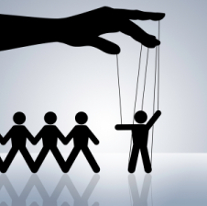
What is a Conflict of Interest?
A situation in which a person is or appears to be at risk of acting in a biased way because of personal interests
Notes:
JAMA definition

Slide 6

Examples of Conflicts of Interest
Gifts, meals, or free medication samples from drug companies
Promotional speaking for drug companies
Having a financial interest in a medical product companies whose product you
use/recommend
Notes:
Self referrals and Stark laws
Dermatology and private equity

Slide 7
Examples of Conflicts of Interest
Incentives for physicians to increase or decrease services
  Fee-for-service (increased services?)
  Capitated payments (decreased services?)
  Procedures vs. non-procedures
Research funding
Physician reporting (impaired, disruptive)

Slide 8
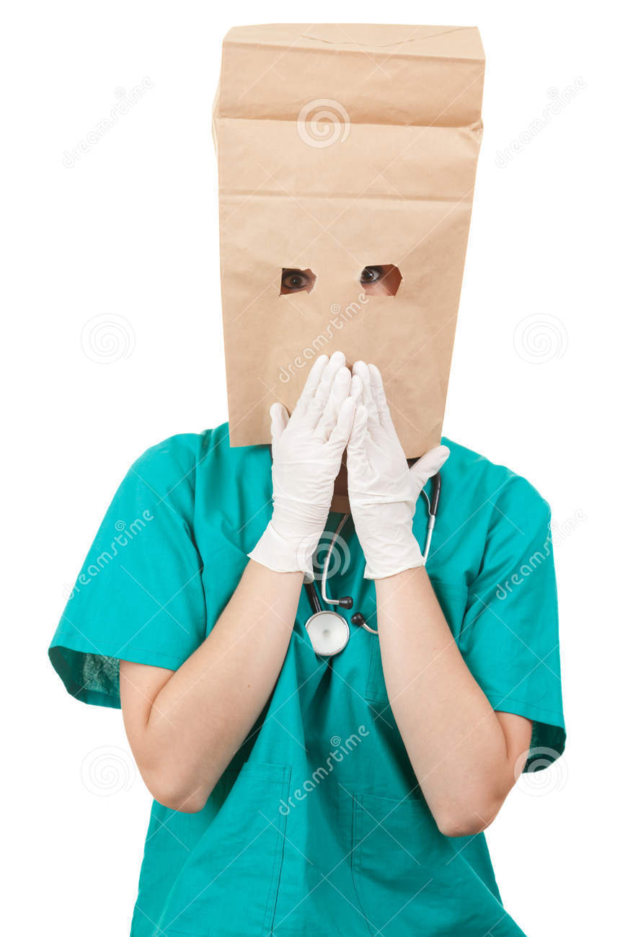
A Conflict of Interest
Does NOT Mean:
  Unethical
  Unprofessional
  Illegal

Slide 9

The Winner is Clear
In conflicts of interest, there is no ethical ambiguity
Physicians must always prioritize their patients’ interests
Notes:
Physicians must report impaired physicians.

Slide 10
What is Not Clear:
“Perceived” Conflicts of Interest
Implies there is no harm and/or no potential of harm
What about the appearance of harm?
  Patients may think physicians are prioritizing other interests over theirs
  Trust may be undermined

Slide 11
“Perceived” Conflicts of Interest
Are concerns misguided?
Aren’t there benefits to healthcare-pharma relationships?
  Is knowing brand name drugs necessarily a bad thing?
Is this insulting to doctors?
Notes:
Less than 1% of doctors think they can be influenced, but 40% think others are influenced

Slide 12

Assessing a Conflict of Interest
What is the likelihood that professional judgment will be influenced or appear to be influenced?
What is the seriousness of the harm or wrong which could result from such influence or its appearance?
What would patients think?

Slide 13
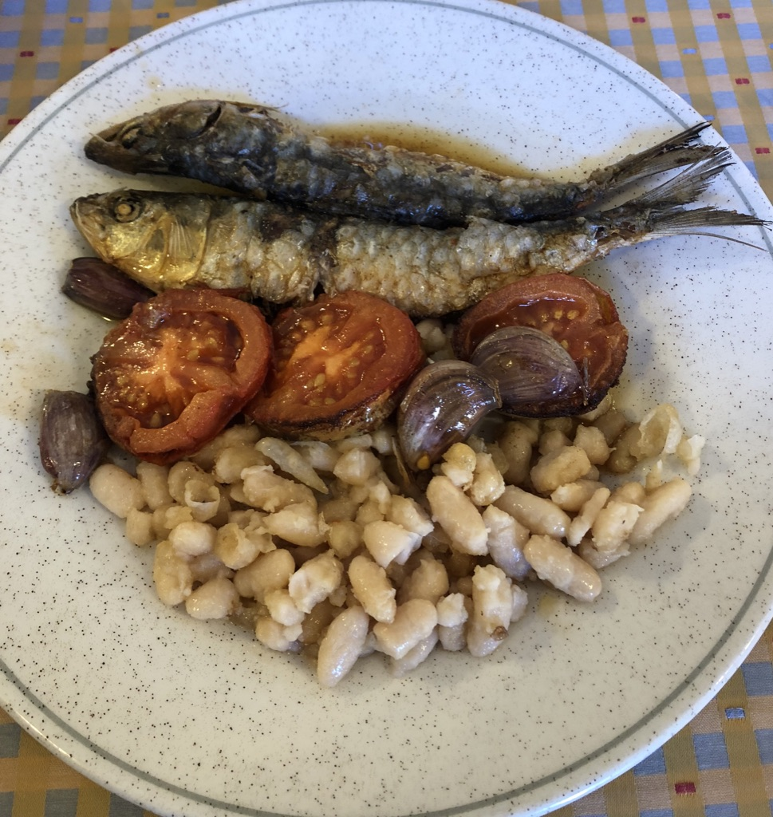
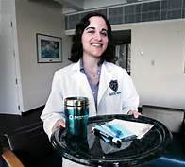

Healthcare and Medical Education
97% of residents found to have at least one item with a pharmaceutical insignia²
93% of medical students have been asked/required by attending to attend a sponsored lunch³
Notes:
More than $60,000 per physician. Mean exposure of a third year medical student: 1x/week
In JAMA as of 2007, 34% of pages were drug ads
97% of residents found to have at least one item with a pharmaceutical insignia²
93% of medical students have been asked/required by attending to attend a sponsored lunch³

Slide 14

Your Opinion
It is sometimes ok for medical students to accept gifts and lunch from drug companies.
  True
  False

Slide 15
Medical Student Opinion (2005)
70% of students believed “it is sometimes okay for medical students to accept gifts and lunch from drug companies because drug companies have minimal influence on students.”
80% of students believed “it is sometimes okay for medical students to accept gifts and lunch from drug companies because most students have considerable debts and minimal income.”
Notes:
JAMA, Sierles et al, 2005 Would you ever fill faculty shortages like this? Does this help young physicians resist the influence of drug companies? However: we have other sources of drug information. They want us to prescribe their drug; we want to prescribe the most appropriate and cost effective drug.

Slide 16

Big Pharma

Slide 17

What about...?
Research and development
Innovation and education
Lack of clear cases of corruption

Slide 18
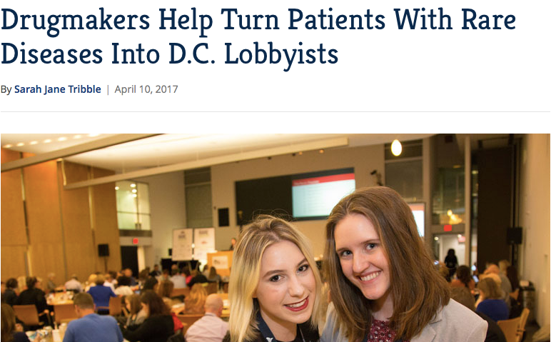

Slide 19
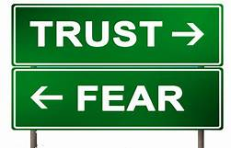
Against Industry-Healthcare Relationships
Undermines public trust
Introduces bias into research, prescribing, and education
Prioritizes other interests above patient interests

Slide 20
Industry and Academia
Employees of industry funders co-authored 87% of publications
92% of trials reported involvement of funders in design
Data analysis:
  Funder involved: 73%
  Academic authors involved: 40%
Trial reporting:
  Funder: 73%
  Academic authors: 99%
33% of respondents reported that academics had final say on design
11% reported disagreements with industry re: design and reporting
Rasmussen K, et al. Collaboration between academics and industry in clinical trials cross sectional study of publications and survey of lead academic authors. BMJ. 2018;363:k3654.
Notes:
Why not punish speeders instead of banning fast cars?
Employees of industry funders co-authored 87% of publications
92% of trials reported involvement of funders in design
84% reported involvement of academic authors
Data analysis involved the funder in 73% / academic authors in 40%
Trial reporting involved the funder in 73% / academic authors in 99%
33% of respondents reported that academics had final say on design
11% reported disagreements with industry re: design and reporting

Slide 21
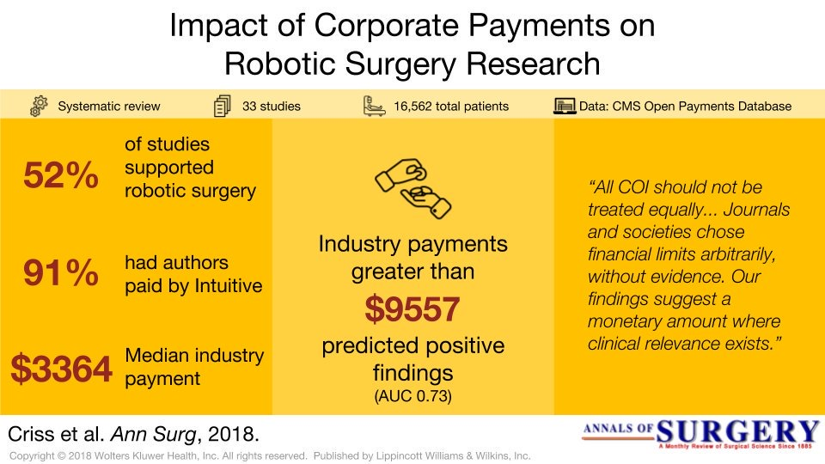

Slide 22
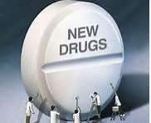
Studies Suggest…⁶
Accepting drug samples was associated with “awareness, preference, and rapid prescription of a new drug.”
Sponsored meals correlated with formulary addition requests for drugs

Slide 23
Against Drug Samples (from amsa.org)
Adair, et al, in a randomized trial, found that residents who were randomized to use samples were less likely to prescribe over the counter medications and more likely to prescribe advertised drugs than residents randomized to agree not to use samples.
Chew, et al, found that in the treatment of hypertension, over 90% of physicians would dispense a sample that differed from their preferred drug choice.
Boltri, et al, found that following prohibition of sample use in their practice, use of first line anti-hypertensive therapy increased from 38% to 61%.

Slide 24
Studies Suggest…^{6,7}
Accepting funding to attend a symposium impacted hospital prescribing practices for 2 years
Resident exposure to drug rep speakers at lunch was associated with dissemination and learning of inaccurate info about the sponsor’s and competitor’s drugs
Physicians at academic medical centers with unrestricted access to drug reps were more likely to prescribe costlier, name-brand drugs
Notes:
Although some positive outcomes were identified (improved ability to iden-
tify the treatment for complicated ill- nesses), most studies found negative outcomes associated with the interac- tion. These included an impact on knowledge (inability to identify wrong claims about medication), attitude (positive attitude toward pharmaceu- tical representatives; awareness, pref- erence, and rapid prescription of a new drug), and behavior (making formu- lary requests for medications that rarely held important advantages over exist- ing ones; nonrational prescribing be- havior; increasing prescription rate; prescribing fewer generic but more ex- pensive, newer medications at no dem- onstrated advantage.)

Slide 25
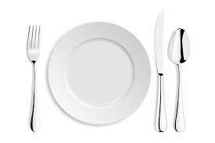
Lunch & Prescribing
Cross-sectional study of 279,669 physicians
Studied physicians who received single meal with a mean value <$20 promoting certain drugs
Showed an association between meals & prescribing
  Increased association with number of meals
  Increased association with costlier meals

Slide 26
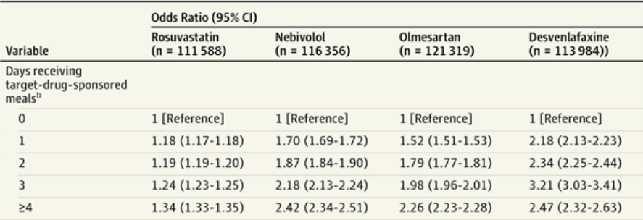
Lunch & Prescribing
DeJong C et al. Pharmaceutical Industry-Supported Meals and Physician Prescribing Patterns for Medicare Beneficiaries.
JAMA Intern Med. 2016;176(8):1114-1122.
Notes:
DeJong C et al. Pharmaceutical Industry-Supported Meals and Physician Prescribing Patterns for Medicare Beneficiaries. JAMA Intern Med. 2016;176(8):1114-1122.

Slide 27
Healthcare and the
Pharmaceutical Industry
Drug companies spent more than $20 billion for marketing to US physicians and more than $6 billion for drug samples in 2004⁵
“” spent $322 million on journal advertising in 2011
Ads return $2.43 to $4.00 in prescriptions for every dollar spent
Notes:
More than $60,000 per physician. Mean exposure of a third year medical student: 1x/week Sierles et al, 2015)
In JAMA as of 2007, 34% of pages were drug ads

Slide 28
Drug Advertising
Assess promotional materials in a critical light as distortions may be present
  Overstatement of efficacy
  Omission/minimization of risk information
  Broadening of indication
  Use of outdated product labeling
Notes:
Vioxx Story; drug ad bingo; absolute vs. relative risk

Slide 29
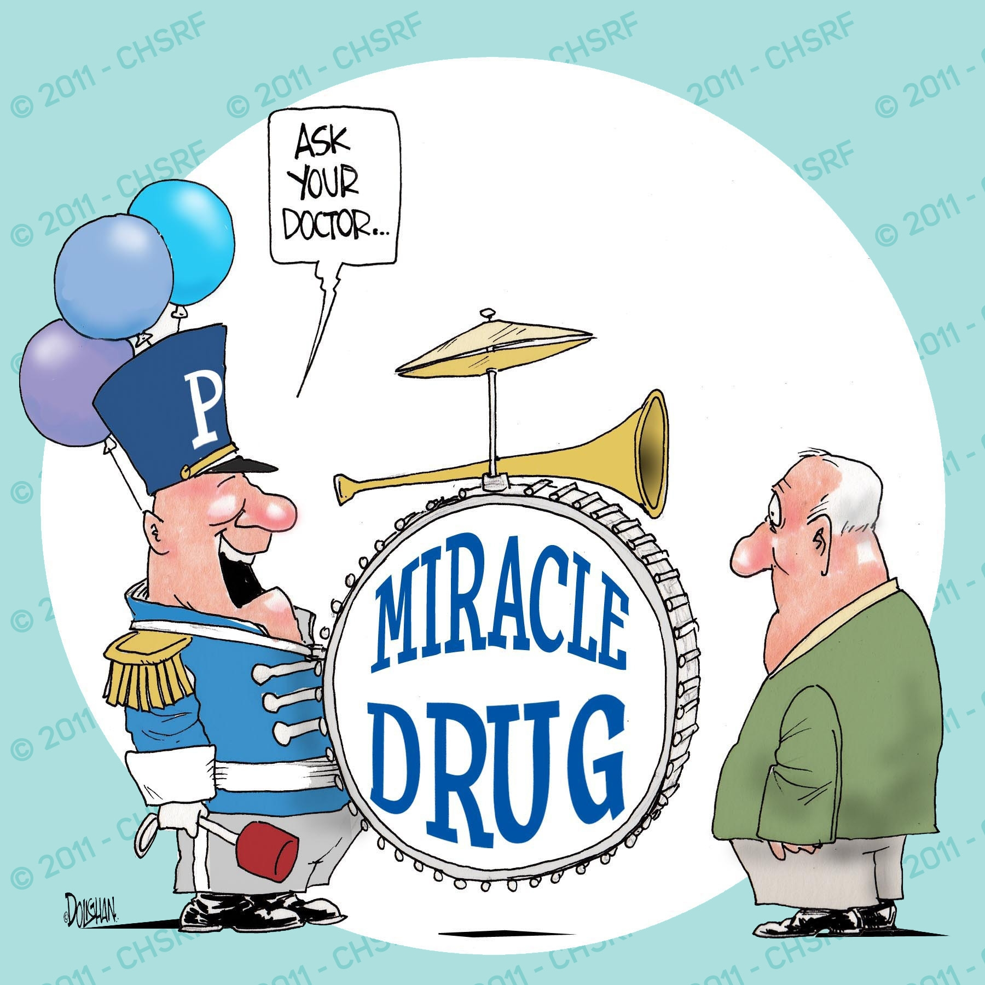

Slide 30
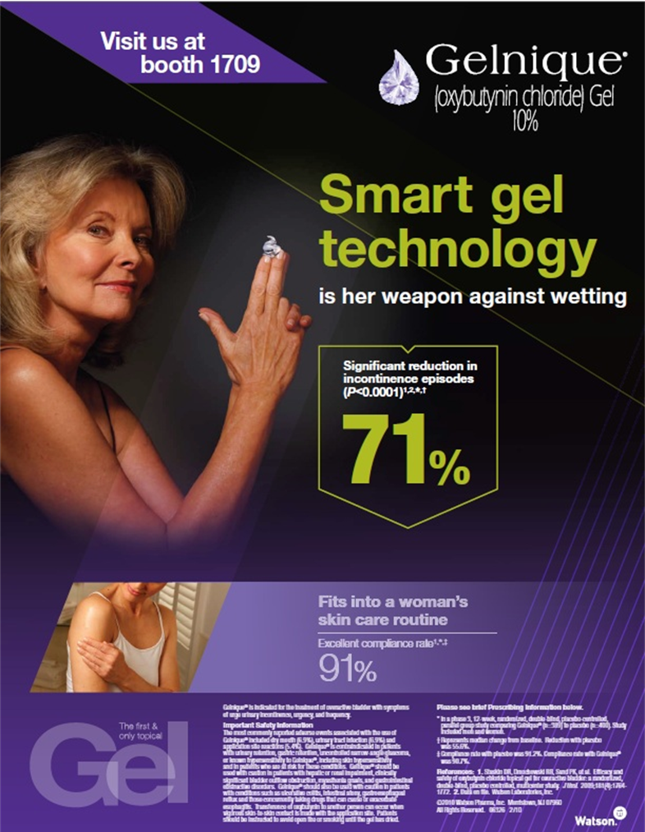

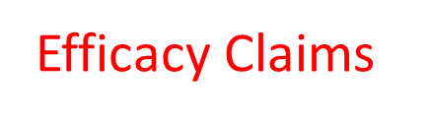


Gelnique (oxybutynin chloride)
Overactive Bladder treatment
Restroom Stall Poster at Conference
Notes:
Adverse effects understated (small font, difficult to read when compared with efficacy)

Slide 31
The Vioxx Story
COX-2 NSAID released by Merck in 1999
Study (2000) showed fewer ulcers and less GI bleeding than patients on naproxen
However, more patients (79/4,000) on vioxx than on naproxen (41/4,000) had serious heart problems or died
Data published in NEJM mention only some of the heart attacks and other CV events
Notes:
Just a few years after the U.S. Food and Drug Administration (FDA) approved Vioxx, the drug was recalled because of the risk of deadly heart attacks and strokes.
When Vioxx hit the market, the goal was to expand the drug’s reach worldwide to as many patients as possible. While Vioxx patients numbered to about 80 million quickly, most didn’t know that the drug was jeopardizing their health.
Vioxx (rofecoxib), a non-steroidal anti-inflammatory drug (NSAID) and a prescription painkiller, was approved for use by the FDA in 1999. In the years that followed, it was mired in scandal. Merck was accused of misleading doctors and patients about the drug’s safety, fabricating study results to suit the company’s needs, continually thwarting an FDA scientist from revealing the drug’s problems and skirting federal drug regulations.
In 2004, Merck withdrew the drug from the market after a study revealed the drug more than doubled the risk of heart attacks and death. By that point, more than 38,000 deaths were related to Vioxx use, and up to 25 million Americans had taken the drug.
The Vioxx Recall and FDA Scandal
Vioxx caused so much damage and destruction that some have called it the worst drug disaster in history. The Vioxx scandal wasn’t just devastating to the injured patients and their families; it also underscored problems within the FDA. Many suspect that the New Jersey-based Merck and the FDA worked together to keep the drug on the market and quiet the health concerns.
The suspicions about the Merck-FDA tie ran deep. They started early on when Merck tried to convince the FDA that Vioxx was better than other NSAIDs because it caused few digestive tract problems. Even before the drug was FDA approved, the company launched its Vioxx Gastrointestinal Outcomes Research study (VIGOR) to determine the digestive risks. While the study did show that Vioxx was easier on the digestive system than other NSAIDs, it also revealed that it increased the risk of heart problems.
After that, Merck continually hounded the FDA to allow the drug to drop the digestive warnings on the label. In February 2001, the FDA approved Merck’s request to change the drug’s label to reflect that it’s safer on the stomach than other NSAIDs. Although that label change would later be overturned, it was a feather in the Merck cap. About the same time, the FDA ordered the company to send doctors a letter explaining the drug’s heart risks. And it wouldn’t be the first time that Merck’s huge marketing monster was reprimanded.
The whole time that Merck was promoting Vioxx as a superior alternative for those with gastrointestinal problems, the company was also brushing aside the drug’s cardiovascular risks. It wasn’t until April 2002, years after the VIGOR trial results showed the risks, that the FDA and Merck decided to include the heart and stroke information on the drug label. Critics would later point to this as evidence of the cozy relationship between Merck and the FDA and the company’s blasé attitude toward the risks.
Vioxx Controversies
When the VIGOR trial results were finally published in the prestigious New England Journal of Medicine, no one knew that it was missing some key information. Later, the public would learn that Merck scientists left out key data on heart patients to make the drug seem safer. The editor of the journal later demanded a correction, but the scientists who conducted the study refused.
While the drug was removed from the market on Sept. 30, 2004, it was just the beginning of the controversies surrounding it. The U.S. Department of Justice and the U.S. Securities and Exchange Commission investigated the company for its deceptive and strong-arm marketing practices. An FDA scientist who discovered the Vioxx heart connection early on said his FDA bosses forced him to quash information that was potentially damaging to Merck. Government officials continually question the relationship between Merck and the FDA.
And perhaps in the most shocking turn of events, and perhaps underscoring Merck’s close relationship with the FDA and other drug-regulatory agencies, advisory panels in both the United States and Canada in 2005 voted that Vioxx could return to the market under certain circumstances and restrictions. So far, Vioxx remains recalled.

Slide 32
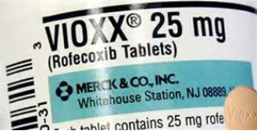
The Vioxx Story
Merck pulls Vioxx off the market in 2004
By that time, 20 million people have taken the drug
The Lancet estimated that 88,000 Americans had heart attacks and 38,000 died

Slide 33
Absolute Risk and Relative Risk
Absolute Risk (AR)
  describes the incidence of a condition in a population.
Relative Risk (RR)
  compares the probability of an event occurring in the exposed group vs. the non-exposed group.

Slide 34
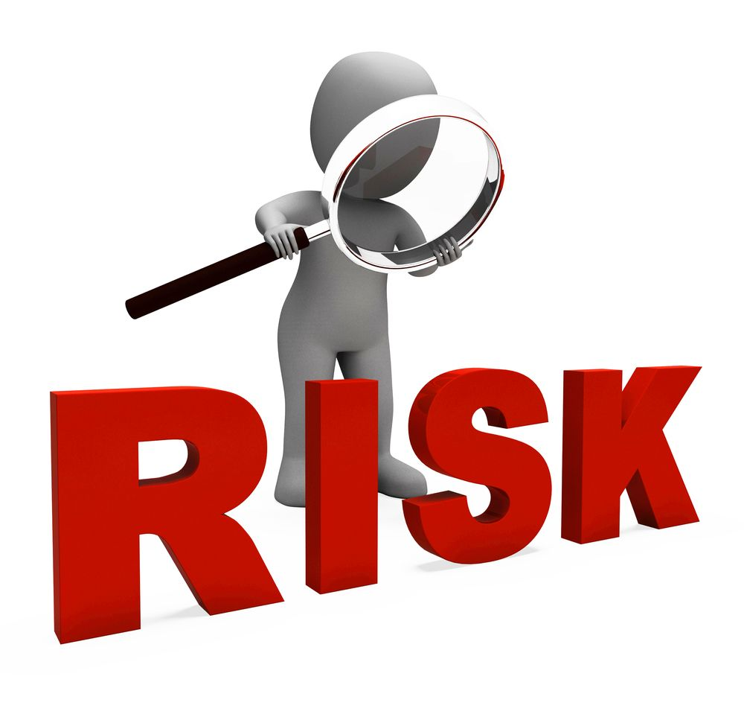
Absolute Risk and Relative Risk
Presenting benefits in relative terms and risks in absolute terms is a classic way to exaggerate benefits and minimize risks.

Slide 35
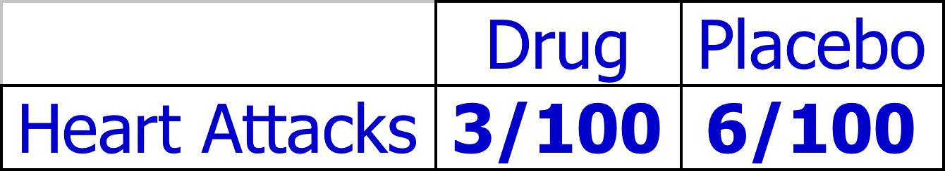
Example
A placebo-controlled trial of a lipid-lowering drug Is performed in 200 people (100 treated with the drug and 100 treated with placebo). Three people on the drug and six people on placebo have heart attacks.

Slide 36
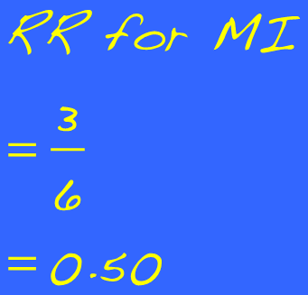
Relative Risk and Absolute Risk
We might say that Drug A reduces heart attack risk by 50% or cuts heart attack rate in half.
We could also say that the heart attack risk is reduced by 3%.

Slide 37
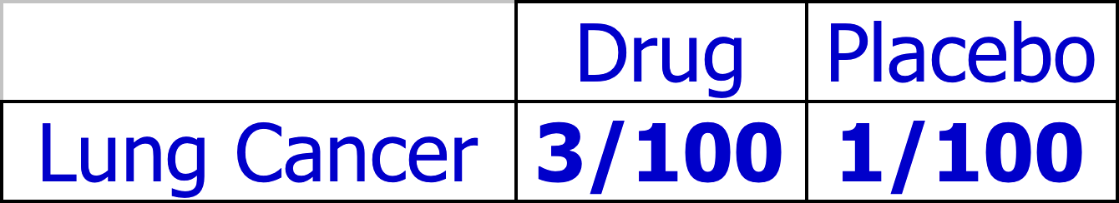
Unfortunately…
Some people in the study develop lung cancer…

Slide 38
Relative Risk and Absolute Risk
We could say that the lung cancer risk increases by 200%.
We could also say that lung cancer risk increases by 2%.

Slide 39

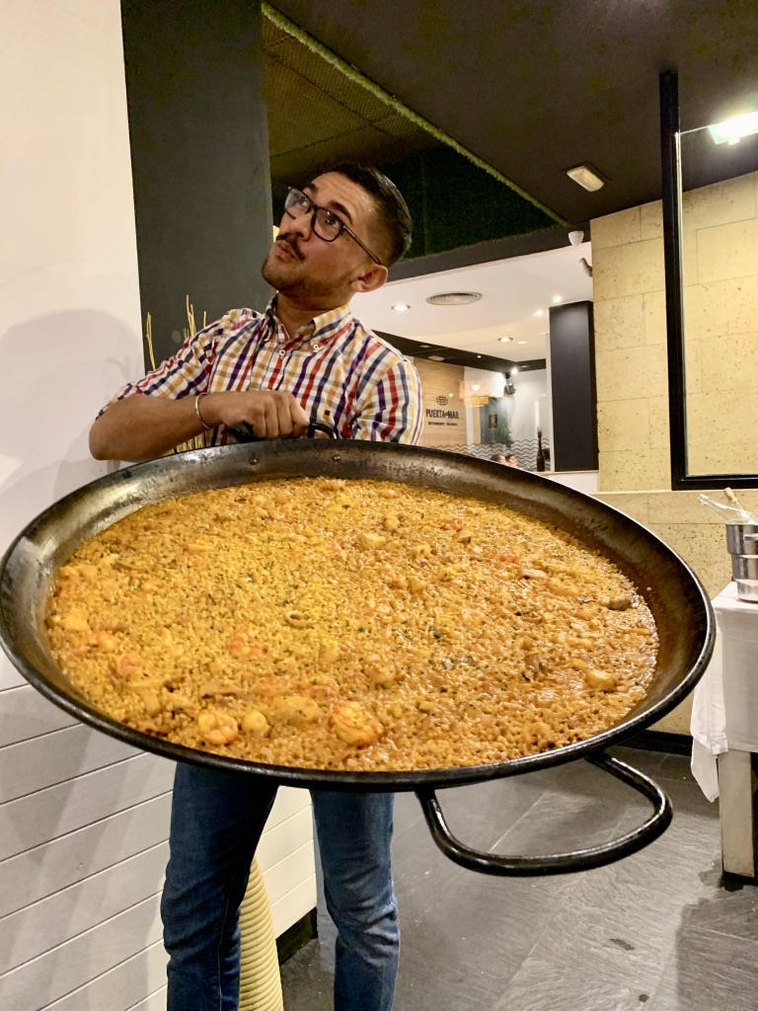

Relative Risk and Absolute Risk
Relative risk makes risks or benefits look bigger.
Absolute risk makes risks or benefits look smaller.
Paella shown in actual size.
Notes:
A 2004 study (Cooper, JGIM 2003; 18:294) showed that 36% of graphs had numeric distortion and 1/3 contained design features that distorted the data.

Slide 40
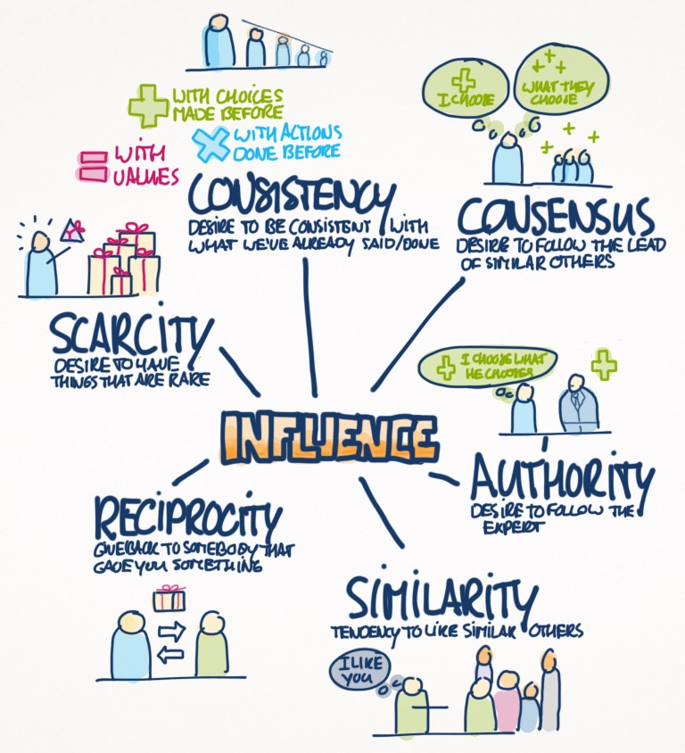

Cialdini’s Principles of Influence

Slide 41

“If we put horse manure in a capsule,
we could sell it to 95% of these doctors.”
-Harry Loynd, former president of Parke Davis
Notes:
1950’s – 1960’s

Slide 42
Checklist for Evaluating Ads
Are the risks relative or absolute?
Is the result statistically significant?
Is the result clinically significant?
Does the size of the effect shown equal the size of the effect in the data?
Are the references “real”?

Slide 43


Slide 44
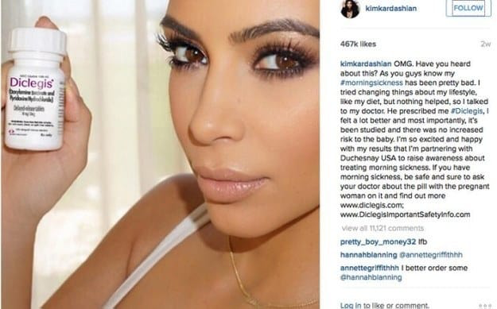

Slide 45
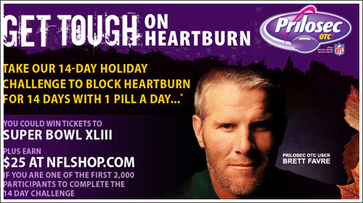

Slide 46
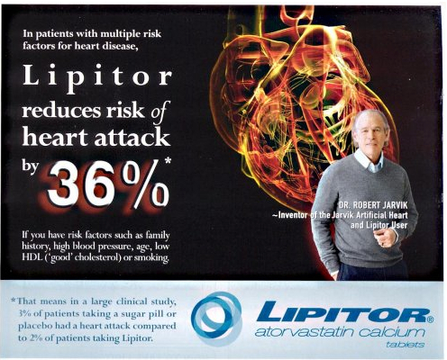

Slide 47
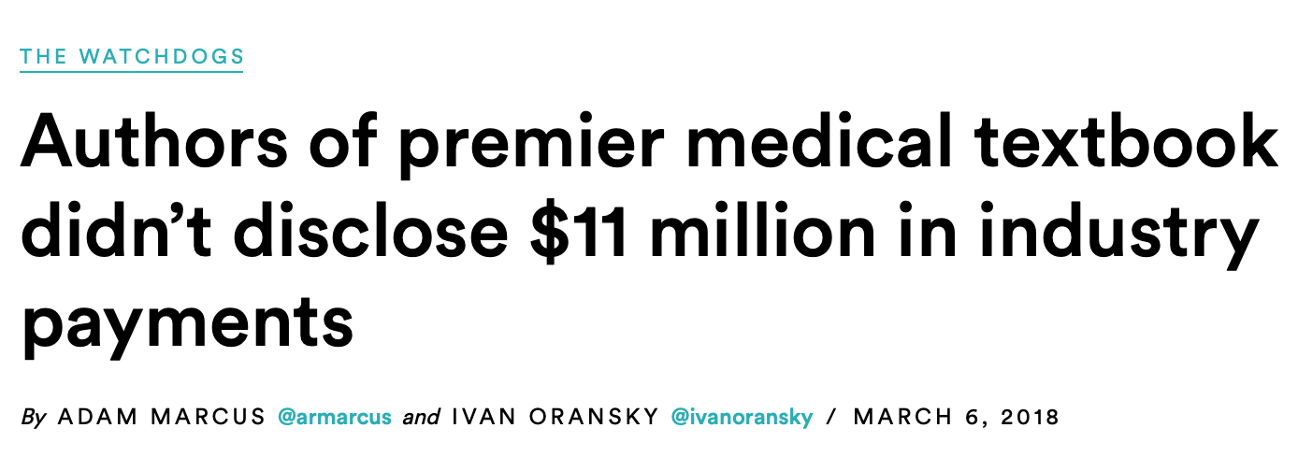
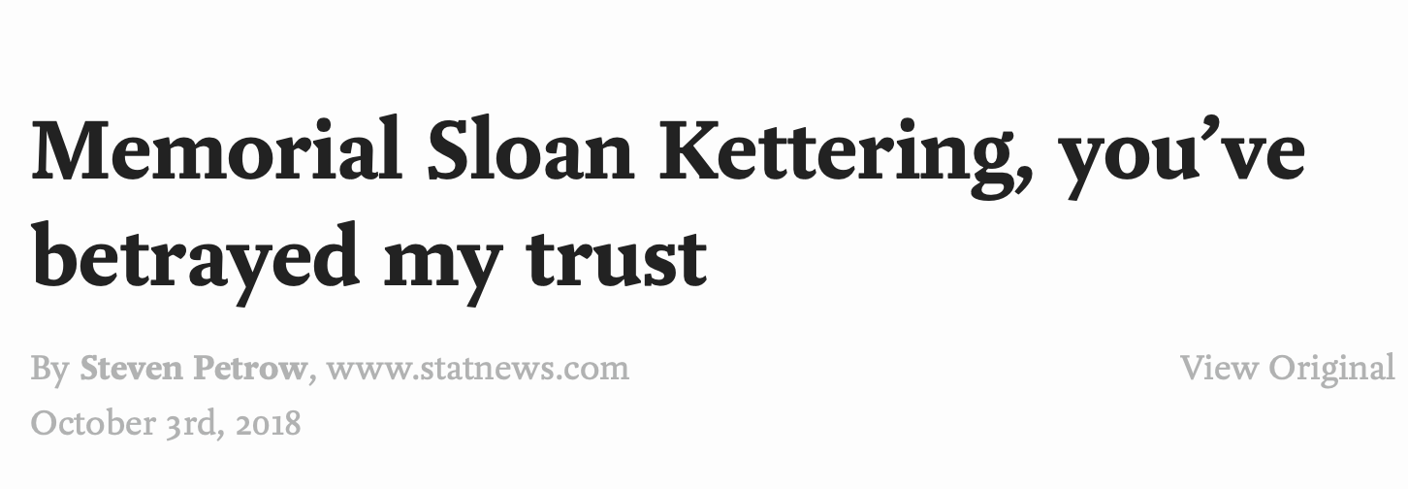
WWPT?
(What would patients think?)

Slide 48
Patient vs. Physician Perceptions⁴
Gift | Not appropriate |  | Influential
 | Patients | Physicians | Patients | Physicians
Trip | 59% | 75% | 56% | 42%
Dinner | 47% | 33% | 48% | 24%
Lunch | 23% | 10% | 29% | 12%
Drug Samples | 22% | 26% | 42% | 55%
Pen | 19% | 4% | 31% | 8%
Notes:
Participants rated 10 pharmaceutical gifts on whether they were appropriate or not for physicians to accept. Overall scores show patients feel gifts are not appropriate and more influential compared with physicians

Slide 49
Disclosure to the Public:
What Would My Patients Think?
  Speakers at CME programs must disclose honoraria/consulting fees in the course syllabus/beginning of presentations
  Physician Payment Sunshine Act 2013
    Drug, device, biotechnology companies must report all payments >$100 /year to physicians by name
    Does not apply to drug samples
    https://www.cms.gov/openpayments/index.html

Slide 50
Managing Conflicts of Interest
When offered a gift, opportunity, or job, assess for conflicts of interest
If asked to speak or write by a drug company:
  Control the content
  Review presentation materials
  No ghost writing!
  Be wary of promoting specific products

Slide 51
Managing Conflicts of Interest
When considering a job, look at the reimbursement structure
  Disclose any economic incentives to patients
  Disclose and recommend options to patients
  Act as patient advocate
  Avoid deception

Slide 52
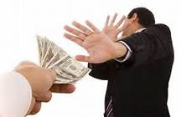
AMA Opinion 8.061:
Gifts to Physicians from Industry
  Decline cash gifts in any amount from an entity that has a direct interest in physicians’ treatment recommendations
  Decline any gifts for which reciprocity is expected or implied

Slide 53

AMA Opinion 8.061:
Gifts to Physicians from Industry
Accept a gift for the physician’s practice only if the gift:
  Will directly benefit patients
  Is of minimal value

Slide 54
USMLE
Modest gifts of <$100 are acceptable if they are medical or educational in nature
May accept meals in association with educational experiences
May accept honoraria (even >$100) for speaking as long as you disclose the financial relationship
Cannot accept cash, sporting event tickets, gift certificates

Slide 55
CESCOM Policy
Students may not accept gifts or meals under any circumstances
Marketing materials may not be accepted
  Pens, notepads, etc. with product logos
Entertainment or recreational items, cash, items for personal benefit may not be accepted at any time regardless of value

Slide 56

To Learn More about Reducing COI
AMSA’s PharmFree campaign
  www.pharmfree.org
Pharmed Out
  http://pharmedout.org/
No Free Lunch
  http://nofreelunch.org/
N.B.: the above sources seek to remove conflicts of interest in healthcare/education
FDA Bad Ads Campaign
  https://www.fda.gov/Drugs/GuidanceComplianceRegulatoryInformation/Surveillance/DrugMarketingAdvertisingandCommunications/ucm209384.htm
The Medical Letter
  http://www.medicalletter.org

Slide 57

Questions?

Slide 58
Summary of Conflicts of Interest
Conflicts of interest in medicine are common
Conflicts of interest must be properly managed in order to maintain the public’s trust
  How likely is harm or appearance of harm?
  How serious is the potential harm?
  What would your patients think?
Assess conflicts of interest, including those related to drug companies, in a critical light

Slide 59
References
Tu HT, Ginsburg PB. Losing Ground: Physician Income, 1995-2003. Washington, DC: Center for Studying Health System Change; 2006. pp. 1–8.
Sigworth SK, Nettleman MD, Cohen GM. Pharmaceutical branding of resident physicians. JAMA. 2001;286:1024-1025.
Sierles FS, Brodkey AC, Cleary LM, et al. Medical students’ exposure to and attitudes about drug company interactions: a national survey. JAMA. 2005;294:1034-1042.
Gibbons RV et al. A Comparison of Physicians’ and Patients’ Attitudes Toward Pharmaceutical Industry Gifts. J Gen Intern Med. 1998, 13(3): 151-154
Gagnon MA, Lexchin J. The cost of pushing pills: a new estimate of pharmaceutical promotion expenditures in the United States. Plos Med. 2008;5:e1.
Wazana, A. Physicians and the Pharmaceutical Industry: Is a Gift Ever Just a Gift? JAMA. 2000; 283: 373-380.
Larkin, I, et al. Association between Academic Medical Center Pharmaceutical Detailing Policies and
Physician Prescribing. JAMA. 2017;317(17): 1785-1795

Slide 60
In Favor of Drug Samples
Improved (underserved) patient access to drugs or services
Can replace expensive prescriptions for acute illnesses
Lowers medication costs for patients
Allows patients to test out medications to see if they tolerate them
Can increase adherence by starting therapy right away

Slide 61
Against Drug Samples
May be misuse due to unregulated storage, handling, and disposal
Can influence prescribing behavior
Supply can be unreliable or inconsistent
Patients tend to want to continue meds after samples run out at higher cost to them

Slide 62
Professional Organizations
AMSA “Just Medicine” campaign (2002)
  Evidence based prescribing instead of marketing based
  Global access to essential medicine
  Removal of Conflicts of Interest in medicine
AAMC – 2008
IOM - 2009
Notes:
Medical schools and academic medical centers are policy leaders regarding conflicts of interest. AAMC set guidelines in 2008; IOM in 2009. Just Medicine launched 2002.
Physician salaries decreased 7% from 1993 to 2005, adding to financial pressures.
Oncologists purchase chemotherapy from pharmacies. They use it in their offices, then bill insurance companies for the cost of the drug plus a percentage-based mark-up. (compare $6 markup on a $100 treatment to $600 on a $10,000 treatment. In 2003, Medicare reimbursement changed – you used to be able to make more than a 6% profit. A Harvard study compared similar drugs which became cheaper vs. ones that held their value. Doctors started doing more outpatient chemo to ramp up volume. They also started prescribing the more expensive drug more. As much as 65% of an oncologist’s salary may come from administered treatments.

