Slide 1
Peers for Change
2018 Ohio Rehabilitation Association
Nov. 8, 2018
2:00pm – 3:30pm
Mary Huber, Ph.D, CRC - Associate Professor; Program Director for Master’s in Chemical Dependency at WSU
Emily Surico, MPH, BSW – Health, Safety & Crime Prevention Initiatives for East End Community Center
Alan Walder, Certified Peer Supporter, Director of the Dayton Fellowship Club

Slide 2
Agenda (2:00-3:30)
Mary – Introduction, Epidemic and Stats (15 minutes)
Emily – East End Community Interventions (Logistics, 20 minutes)
Mary – Definition of Certified Peer Supporters (CPS)
Alan - What is the Dayton Fellowship Club?
      Personal experience as a certified peer supporter (15 minutes)
Mary - Barriers we encountered Lessons learned (15 minutes)
All- What can you do?
All - Question and answer (20 minutes)

Slide 3
Today’s Goals:
Examine the opioid epidemic and the federal, state and local level.
Describe evolution and community interventions in East End of Dayton area.
Review the role of the Certified Peer Supporter.
Describe peer support study.
Examine the role of rehabilitation professionals.
Discuss next steps.
Answer questions.

Slide 6
Montgomery County Accidental Deaths
Notes:
http://www.mydaytondailynews.com/news/local/the-overdose-epidemic-shifting-dayton/Sq8LWkPvPO4TO0adxeGkrI/

Slide 8
The Epidemic in Ohio and Dayton
Ohio
In 2015, 1,424 people died in Ohio due to heroin overdose (Ohio Department of Health)
In 2017, 2,590 people died of any opioid overdose (Ohio Department of Health)
Dayton
In 2015, 117 people died from heroin overdose in Dayton (Public Health- Poison Death Review)
In 2017, 282 people died from any opioid overdose in Dayton (Public Health-Poison Death Review)

Slide 9
Opioid Use Disorder among People with Disabilities*
APTA has contributed to an effort that may help shed light on an often-overlooked facet of the opioid crisis—the impact of OUD on PWD. While final directions have not been laid out, the comments are helping to shape further calls for research on some important considerations for this population, such as barriers to addiction treatment, difficulty in accessing nonpharmacological pain management, and the relationship between traumatic, disabling injury and opioid misuse.
*American Physical Therapy Association (APTA)

Slide 10
Substance Use Disorders among people with Mental Health Disorders: Common, Recurrent, and Serious
According to SAMHSA’s 2014 National Survey on Drug Use and Health (NSDUH) an estimated 43.6 million (18.1%) Americans ages 18 and up experienced some form of mental illness. In the past year, 20.2 million adults (8.4%) had a substance use disorder. Of these, 7.9 million people had both a mental disorder and substance use disorder, also known as co-occurring mental and substance use disorders.
* https://www.samhsa.gov/disorders

Slide 11
The Relationship between the Epidemic and Crime
Addictions are directly related to 92% of property crime in Dayton.
Courts are overwhelmed, jails are filled with individuals because of an addiction and treatment facilities are unable to meet demand.

Slide 12
Some Consequences of the Opioid Crisis
The sum of the opioid crisis has led to $55 billion in health and social costs every year, HHS reported, and the amount is likely to continue to grow as the problem accelerates.
The opioid crisis has also created a large need for specialization in substance abuse counseling.
National Public Radio (NPR) reported on a study that found a 3,000 percent rise in health care claims for individuals for opioid dependence between 2007 and 2014.

Slide 13
Some Consequences of the Opioid Crisis
These increased overdose deaths and addiction issues has led to counselors having a larger workplace presence to help individuals who might have been recently laid off or laid up with an injury that a doctor prescribed painkillers to treat.
According to HHS, Ohio, Pennsylvania and West Virginia were among the 13 states that experienced 19–35.5 drug overdose deaths per 100,000 in the population.

Slide 14
Some Consequences of the Opioid Crisis
States hit hardest by manufacturing and industrial downturns as well as those with large rural populations that have seen an increase in the unemployment rate have been especially affected by overdose deaths and addiction issues.

Slide 15
Evolution of East End’s New Initiatives)
2013-2014: Conversation for Change (C4C)
2015-2016: Getting Recovery Options Working (GROW)
2017-2018: Peers for Change (p4C)
Notes:
EMILY
1.) Byrne Grant focuses on 5 objectives and strategic interventions that focus on prevention, enforcement, intervention, beautification, treatment, research and sustainability. A cross-sector team is formed between partners in this room and others.
Objective 4: Addresses the high opiate-related overdose death rate in East Dayton through improved treatment options for users- Medically Assisted Heroin Addiction treatment Center and Conversation for Change
2.) BCJI asks East End to work with Dayton Police on gathering data in the Neighborhood Revitalization Zone (NRZ) (45403 and 45410) to understand patterns of crime. DPD interviewed people in custody that were picked up for property crimes. 92% admitted to having a drug problem with heroin. Heroin is the root cause of an increase of deaths in East Dayton. DPD begins to be trained on naloxone administration.
3.) Jan: East End invites Cornerstone into the dialogue, EE tours one of their other facilities
May: Only 4 people attend the first C4C event (2 access treatment, all 4 are trained on naloxone
Oct: Community is engaged and provides input and support into treatment center
4.) TTNA; Neighborhood defense Plan/Good Neighbor Agreement/MCDFC members discuss a need for the Front Door
5.) Opening May 26th and June 1st start receiving patients; 352 people and 14 events have taken place to date and a total of 16 by the end of the year. Participation 60+/Front Door is ready to launch. Getting Recovery Options Working (FOA/DPD/East End/Cornerstone Project) OD/Narcan Saves
Community Outreach Center Stats 8/2016
Overall Stats
44% Retention Rate
87 Individuals
38 Still Compliant
20 Discharged for Non Compliance
29 No Shows/Didn’t Return for Appointment
Front Door Program Stats
38% Retention Rate
24 Individuals Brought In
9 Still Compliant
7 Discharged for Non Compliance
8 Did Not Return after receiving assessment

Slide 16
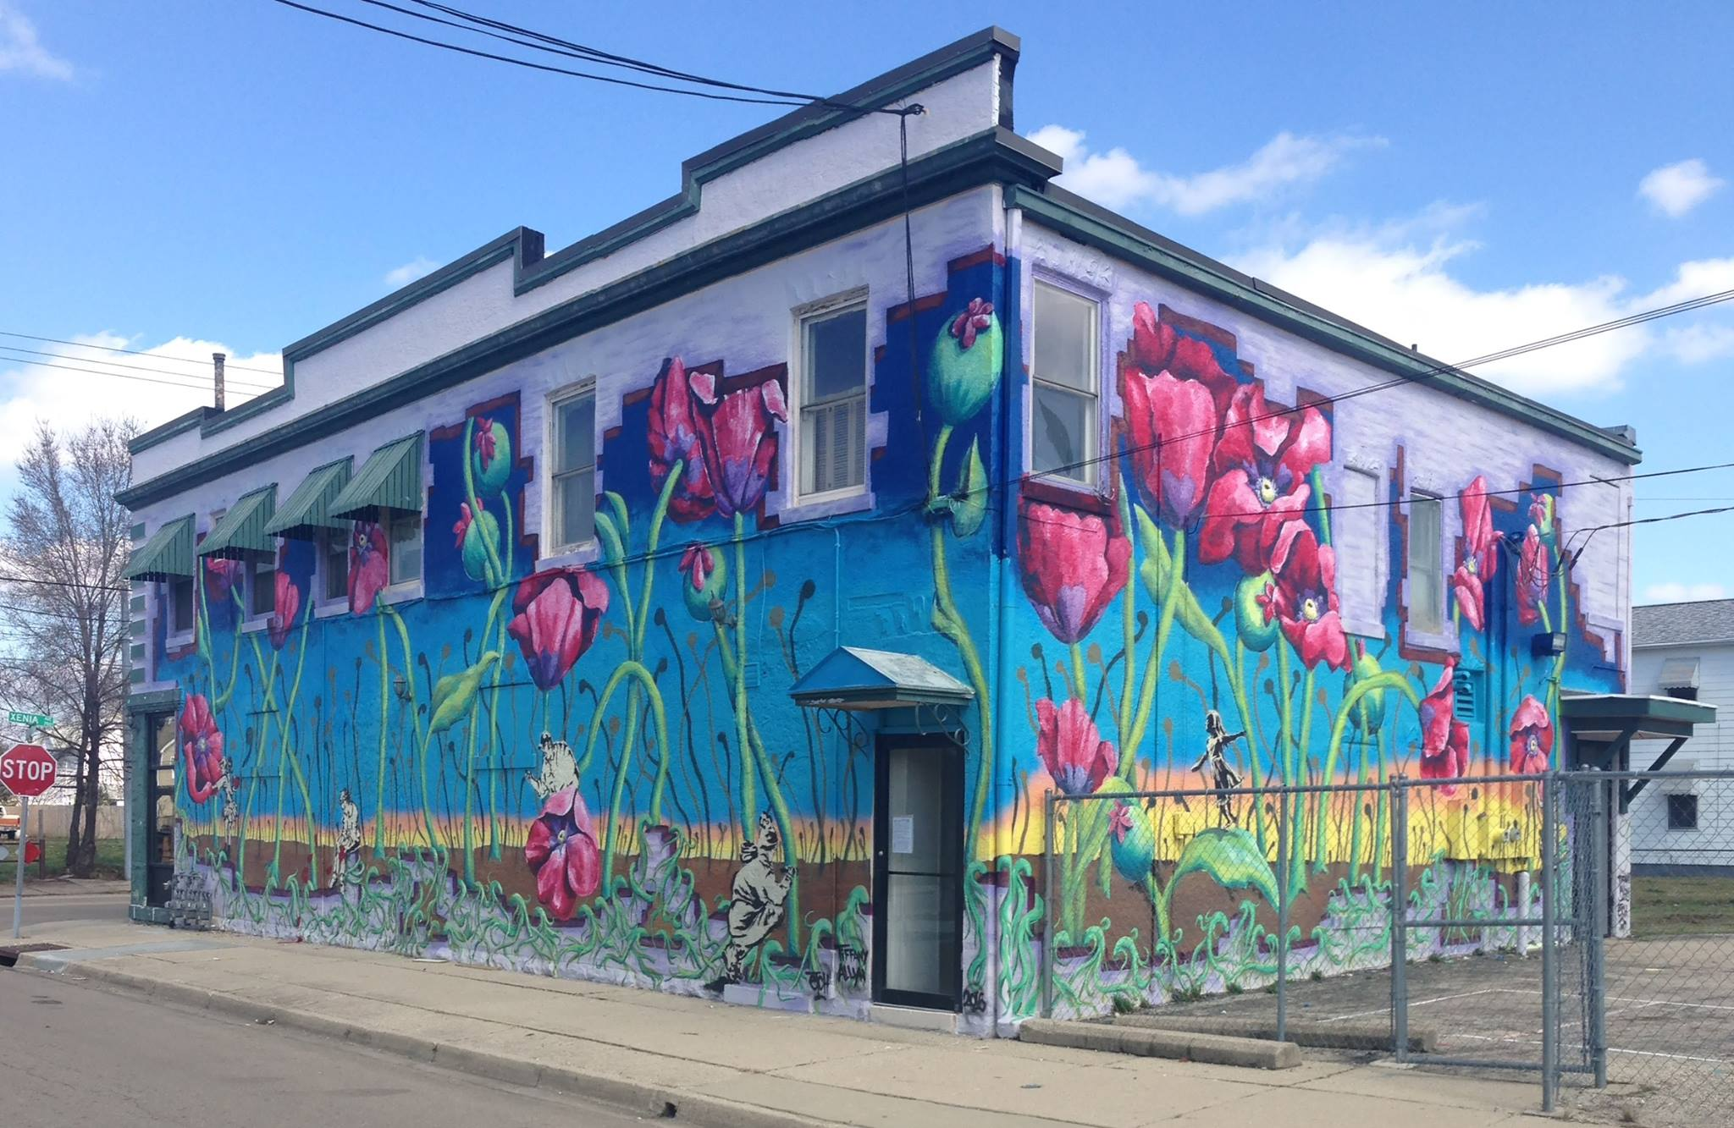

Slide 17
Origins of Conversations for
Change (C4C)
C4C was designed to be part of the solution and started as a collaborative pilot project in 2014.
East End Community Services, ADAMHS Board, WSU, Dayton Mediation Center, other partners.
Office of Justice Programs, Byrne Community Revitalization Grant.
Made up of people that care.

Slide 18
What is the purpose of C4C
The purpose of C4C is to provide a supportive, safe place for individuals struggling with addiction to gather with family and friends and learn about their barriers and varieties of treatment and options available for recovery.
C4C is a collaborative pilot project one of many community projects housed at East End.
Initially funded by the Office of Justice Programs, Byrne Community Revitalization Grant

Slide 19














Partners
Dr. Mary Huber
Dr. Richard Stock
Probation Department
Adult Probation

Slide 20
Evolution and Next Steps at
East End: GROW
Getting Recovery Options Working (GROW)
GROW - outreach team consists of law enforcement, a Medically Assisted Treatment (MAT) provider, peer-and-family support service provider, and an individual from a local community based organization.
Conduct weekly home visits to individuals (and or their families) who have undergone a naloxone resuscitation within the past week.
Purpose is to deliver information kits about resources available in the community, provide naloxone refills, and encourage and support the decision to seek treatment.
Notes:
Community Outreach Center Stats 8/2016
Overall Stats
44% Retention Rate
87 Individuals
38 Still Compliant
20 Discharged for Non Compliance
29 No Shows/Didn’t Return for Appointment
Front Door Program Stats
38% Retention Rate
24 Individuals Brought In
9 Still Compliant
7 Discharged for Non Compliance
8 Did Not Return after receiving assessment

Slide 21
COOCLI Grant (P4C)
In 2017, East End was awarded in the first round of competitive subawards for the Combating Opioid Overdose though Community-level Intervention (COOCLI) grant program.
East End hired two full-time Certified Peer Supporters (CPS) to work with the GROW and C4C initiatives and conduct a study to evaluate the effectiveness of peer support services.

Slide 22
COOCLI Grant (P4C)
In the first three quarters of this grant, CPS made 58 new contacts at C4C events, engaged 87 new contacts through GROW home visits, and helped 31 GROW contacts enter treatment.
The proposed program for the current grant renewal application will be a continuation of the work begun with the first COOCLI grant that will allow us to enhance and expand existing efforts.

Slide 23
What is peer support?
Peer support services are an evidence-based mental health model of care which consists of a qualified peer support provider who assists individuals with their recovery from mental illness and substance use disorders.
Peer specialist services are provided by trained and certified individuals who identify as having personal lived experience with a mental health and/or substance use condition.
Peer specialists assist individuals in developing skills and finding resources to overcome barriers to the self-identified goals.

Slide 24
What are the duties of a peer support specialist?
Peer Support Specialists strive to empower individuals to achieve their hopes, dreams, and goals, and connect them with their personal recovery journey.
Peer support is not intended to be a replacement for existing services or professional roles, but is designed to complement them (Bradstreet, 2006).

Slide 25
Why is peer support important?
Peer support networks help create a safe, caring and inclusive space for students to connect with peers.
They can also increase person sense of belonging and positive mental health by fostering meaningful relationships.
Other positive effects of peer support networks include: leadership opportunities.

Slide 26
What does a peer support specialist NOT do?
It is NOT your role as a Peer Support Specialist to...
...Be a superhero (but you can wear a cape)
...Be their therapist
...Tell them what to do
...Be their spokesperson
...Be the resource (connect to resources rather than being the sole resource to meet their needs)
...Be the star
...Be their chauffeur
...Be their babysitter
...Be their friend (clear boundaries, code of ethics)
...Police them

Slide 27
Position: Certified Peer Recovery Supporter
Hours: Full-time, M - F 8 am - 4:30 pm (hours may vary)
Starting Salary: $13.22 – $18.17 hourly
Minimum Qualifications:
High School Diploma or GED
Current valid Ohio driver’s license, insurance & access to a motor vehicle
Must be in recovery from substance use disorder
Must have or acquire State of Ohio Peer Recovery Supporter certification within 6 months of employment
Must be highly compassionate and have excellent communication and interpersonal skills
Have the ability to build trusting and impactful relationships with the client/consumer
Preferred Qualifications:
Two years or more of recovery from substance use disorder
Chemical Dependency Counselor Assistant (CDCA)

Slide 28
Position: Certified Peer Recovery Supporter
Responsibilities include but not limited to:
Conduct community outreach to client/consumers, families and support systems
Mentor and develop meaningful and trusting relationships with clients/consumers and their families
Coordinate client/consumer arrival and departure for services
Work closely with criminal justice system and various social service agencies
Arrange and provide transportation, manage follow-up appointments
Work with agency staff members to coordinate services
Use own unique, life –altering experience in order to guide and support others
Conduct outreach to clients/consumers who are seeking recovery
Performs individual, group, community and family education
Provides crisis intervention and de-escalation techniques with clients
Refers clients to community programs/services and conducts follow-up as necessary
Compiles client records and maintains documentation according to program and accreditation standards and protocols
Maintains confidentiality, respect client’s privacy, routine, and independence as much as possible
May be required to play an active role in the event of a public health emergency, which may include changes in responsibilities and working hours

Slide 29
Alan’ Experience
Example of the process:
Barriers
Successes
Flexibility

Slide 30
Expected Outcomes from CPS
P4C will decrease use of substances (<32% 3 months)
P4C will increase treatment involvement (12)
P4C will increase (SF-12) quality of life (>21% 3 months)
P4C will increase social support and community engagement (RAMCO)
P4C will increase employability

Slide 31
Lessons Learned
Hiring (new registry for CPS)
Training needs
On going training needs
Relapse is part of the disease (even for CPS)
Support
Documentation

Slide 32
Future Directions
Continue to teach and modify the training curriculum.
Replicate Peers for Change (P4C).
Develop a tool kit that can be adapted to different communities.
Work on sustainability.
Disseminate findings.
Publish articles (research) supporting the need for CPS.
GET MONEY

Slide 33
How Can I Help?
Role of Rehab Educators & Professionals in the Opioid Crisis
According to a National Safety Council survey:
● More than 70 percent of workplaces are impacted by prescription opioid misuse and abuse.
● Just 13 percent of employers are confident they can spot signs of misuse.
● 76 percent don’t have training or resource to close the knowledge gap.

Slide 34
How Can I Help?
The Role of Rehab Educators & Professionals in the Opioid Crisis
81 percent of employers said that their policies lacked at least one critical element of a drug-free workplace program.
70 percent of employers have expressed the desire to help employees struggling with dependency return after completing some form of treatment.

Slide 35
            Questions?

