Slide 1
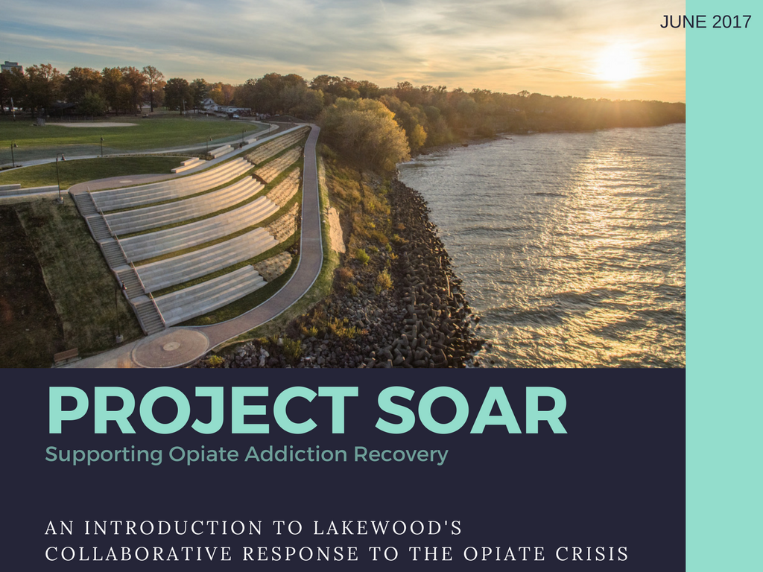

Slide 2
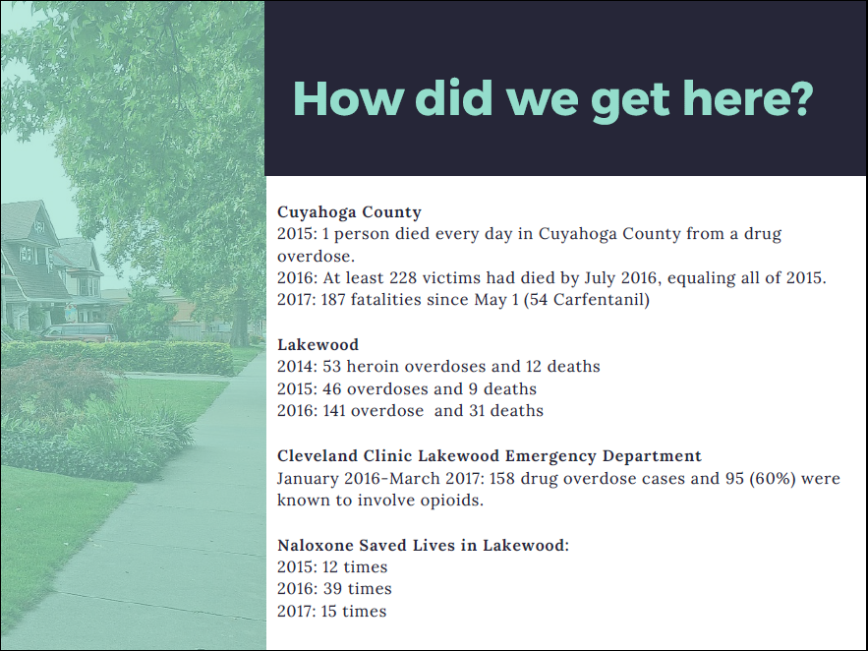
Notes:
2015 was 46 OD 9 deaths
2014 was 53 OD 12 deaths
141 overdoses and 31 deaths

Slide 3
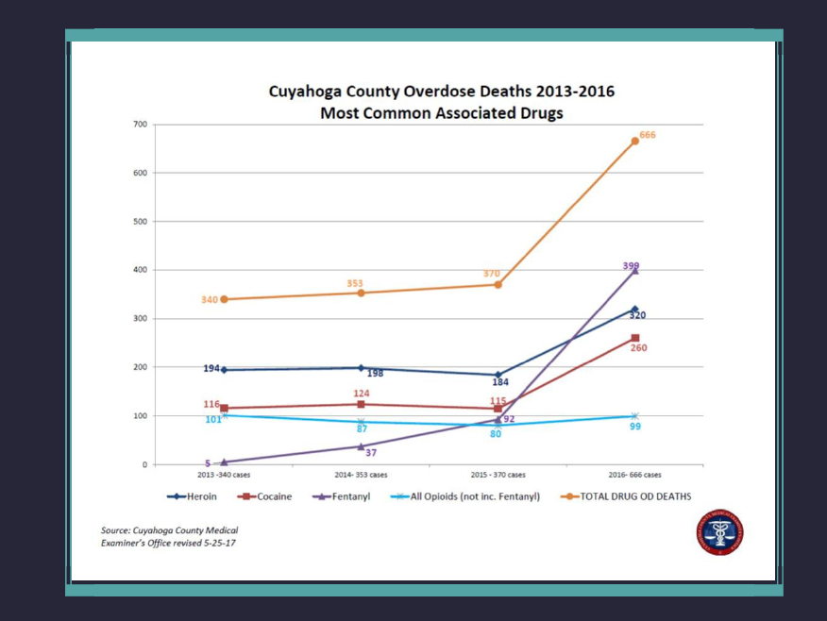
Notes:
Previously, 2-4 mgs was sufficient to save someone; by 2016, 6-10 mg of Naloxone was needed to revive many victims of overdose. City administrators are also alarmed by the fact that approximately 50% of all overdoses occur among Lakewood residents, not visitors from other communities. Besides the human toll, these cases represent a significant drain on Lakewood’s first responders: two police cars and three fire units are typically dispatched when a patient is not breathing. Strain on first responders
In 2015, the City of Lakewood hosted Heroin and Hope, a large-scale community conversation and its first community naloxone training and distribution, with over 300 in attendance.

Slide 4
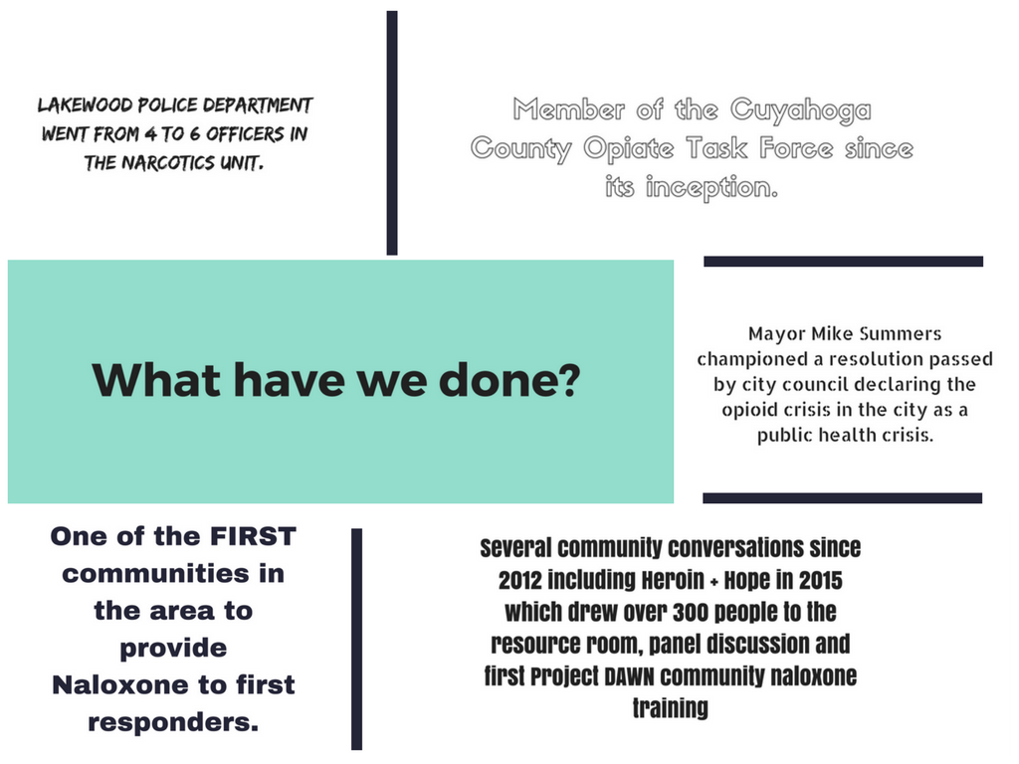
Notes:
bringing city, county, state and federal organizations and representatives together to discuss the resources available, the gaps in the resources, how to assist individuals facing addiction by providing adequate support services and funding and by developing adequate ways of communicating how to access resources.
a move qualifying Lakewood for additional government funding to address the issue. Lakewood is doing more than other suburban communities to battle the addiction problem and still much more can be done.

Slide 5
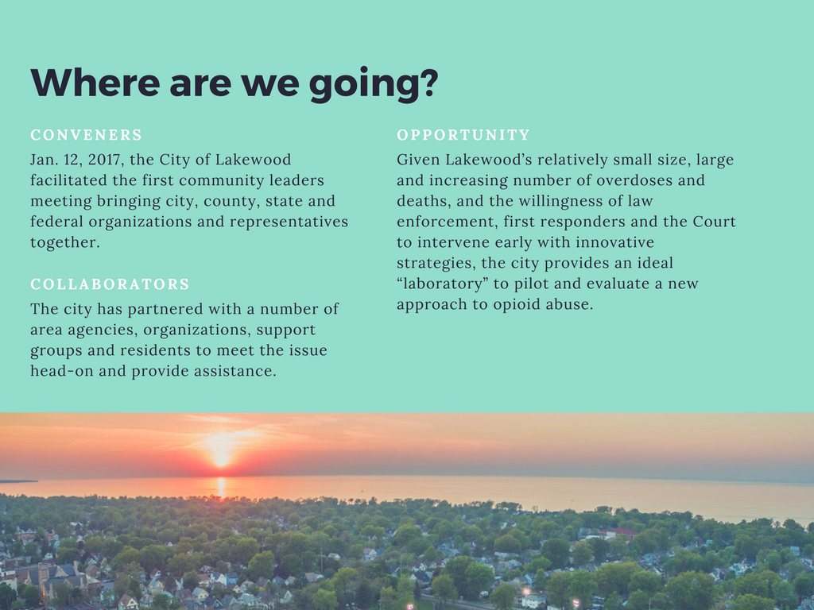

Slide 6
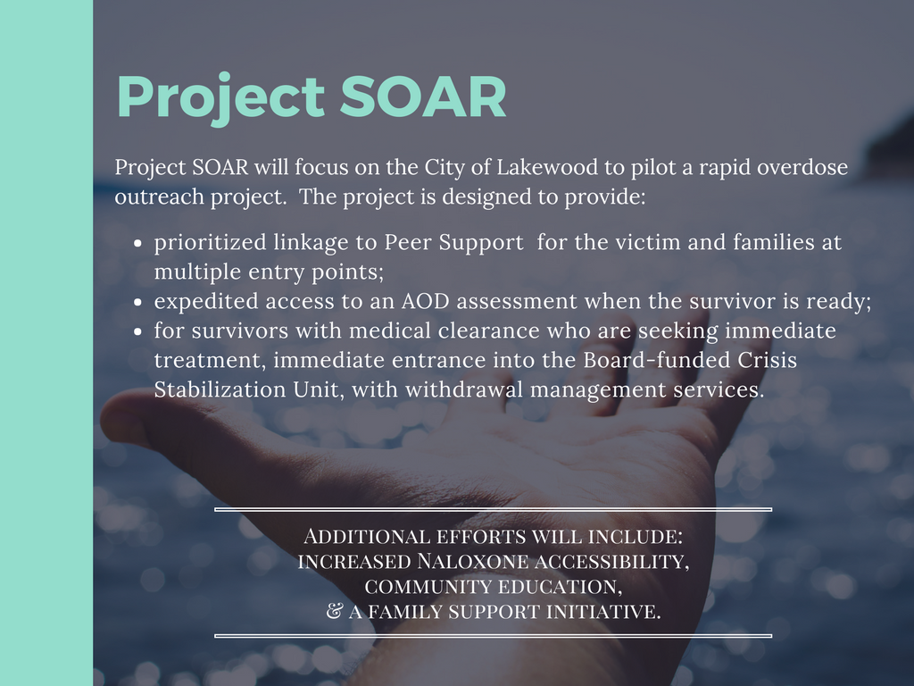

Slide 7
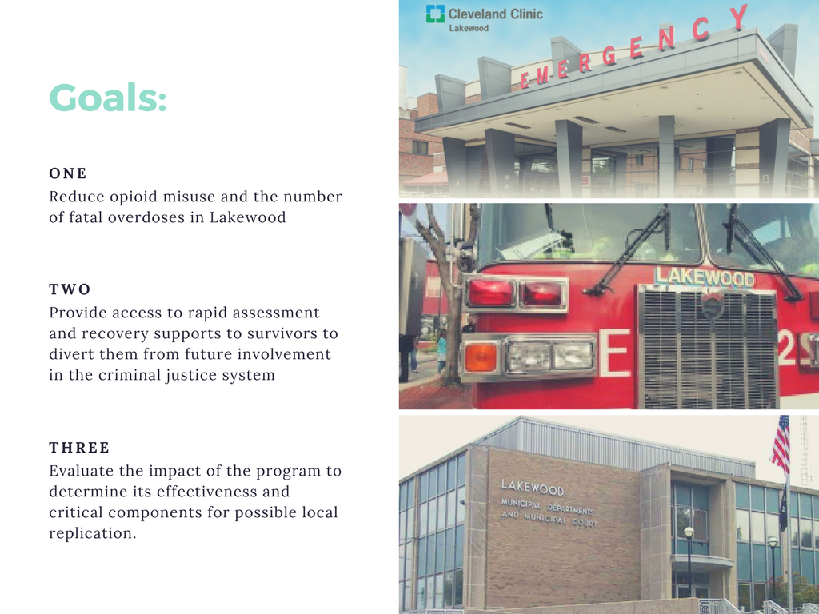
Notes:
This will enable law enforcement and emergency services to divert persons to needed treatment and avoid deeper involvement in the criminal justice system. Individuals will be connected to assessment and peer support at the earliest possible point following an overdose, to reduce the number of fatal overdoses in the future.

Slide 8
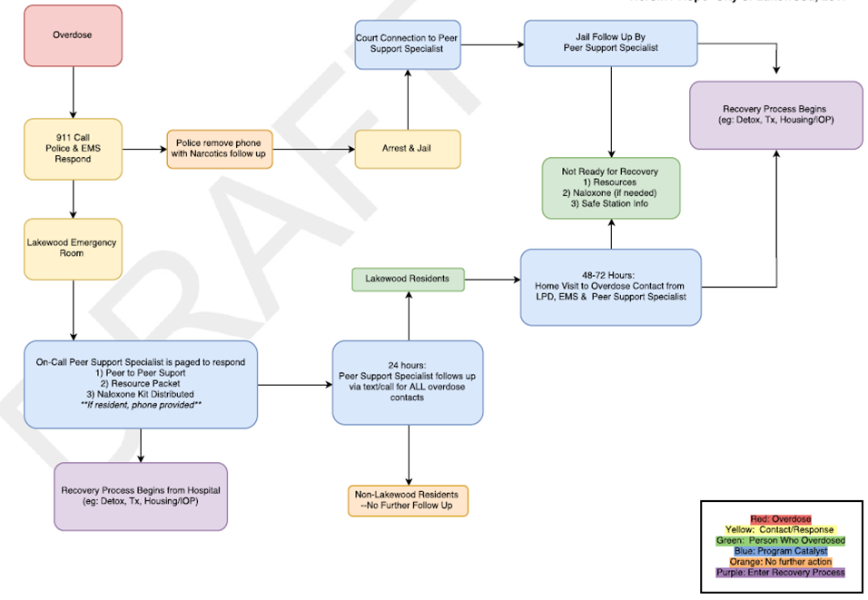

Slide 9
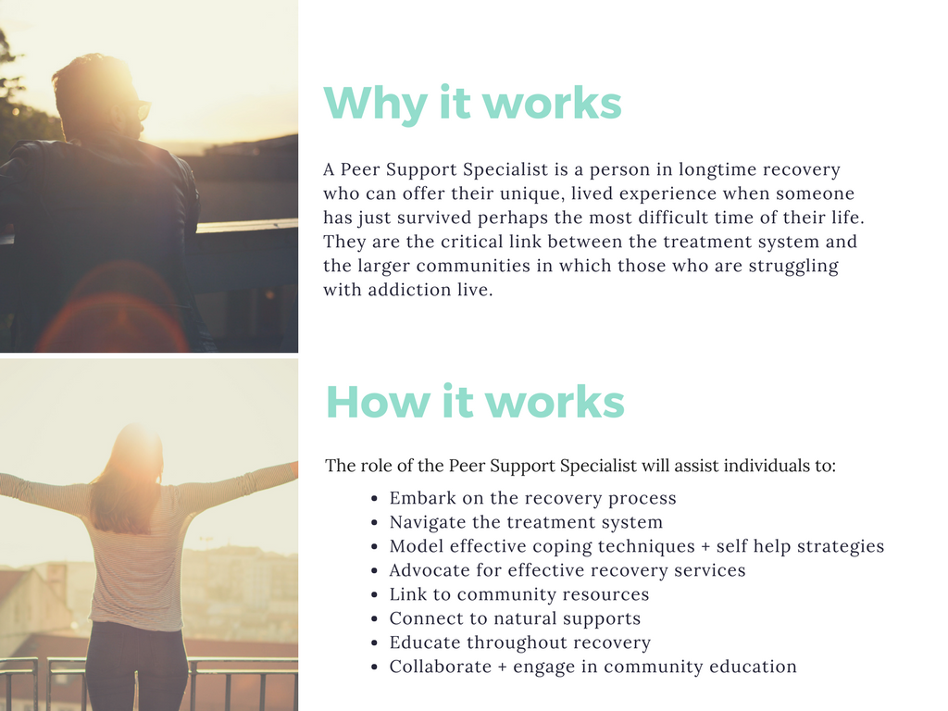

Slide 10
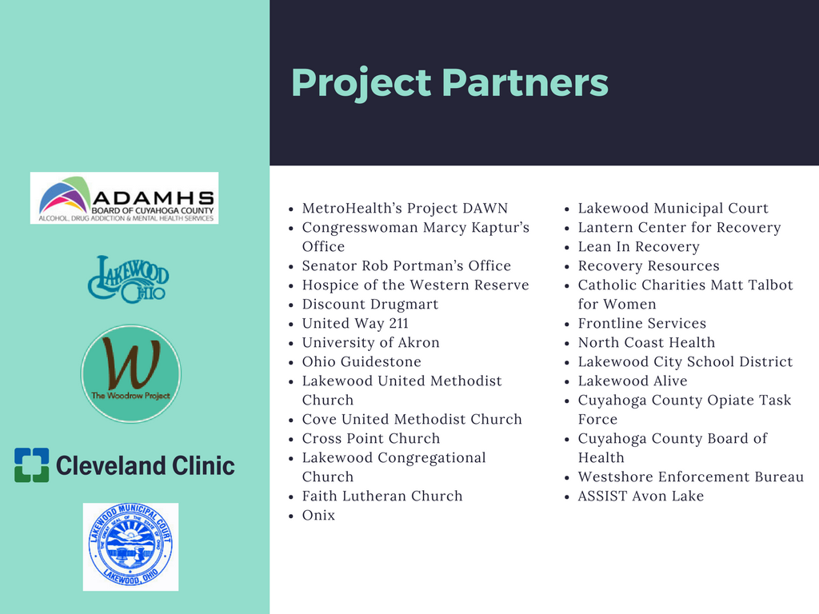

Slide 11
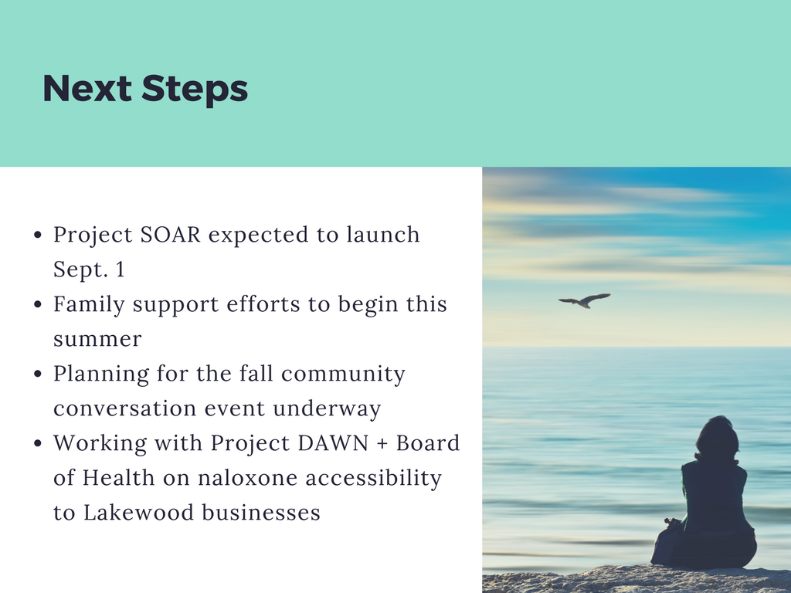

Slide 12

Notes:
Project SOAR Point of Contact :
Katie Kurtz
(216) 529-5011 or katherine.kurtz@lakewoodoh.net
Gina Bonaminio

