Slide 1
PDMP Track:
Improving Utilization of PDMPs
Presenters:
Joe Adams, RPh, President, National Association of Boards of Pharmacy
Danna E. Droz, JD, RPh, Prescription Monitoring Program Liaison, National Association of Boards of Pharmacy
Shawn A. Ryan, MD, MBA, Assistant Professor, Department of Emergency Medicine, University of Cincinnati; Chair, Quality and Patient Safety, Jewish Hospital-Mercy Health Partners
Chris Baumgartner, PMP Director, Washington State Department of Health
Moderator: Karen H. Perry, Co-Founder and Executive Director, Narcotics Overdose Prevention and Education (NOPE) Task Force, and Member, Rx Summit National Advisory Board

Slide 2
Disclosures
Joseph Adams, RPh; Danna Droz, JD, RPh; Shawn Ryan, MD, MBA; Chris Baumgartner, BS; and Karen H. Perry have disclosed no relevant, real or apparent personal or professional financial relationships with proprietary entities that produce health care goods and services.

Slide 3
Disclosures
All planners/managers hereby state that they or their spouse/life partner do not have any financial relationships or relationships to products or devices with any commercial interest related to the content of this activity of any amount during the past 12 months.
The following planners/managers have the following to disclose:
  Kelly Clark – Employment: Publicis Touchpoint Solutions; Consultant: Grunenthal US
  Robert DuPont – Employment: Bensinger, DuPont & Associates-Prescription Drug Research Center
  Carla Saunders – Speaker’s bureau: Abbott Nutrition

Slide 4
Learning Objectives
Describe current practices in interstate sharing of PDMP data.
Investigate strategies states are using to integrate PDMP data with health care records.
Outline the components and results of Washington’s program to provide healthcare organizations with seamless access to PDMP data.
Identify best practices in integration and interoperability that participants can implement in their states.

Slide 5
Improving Utilization of
Prescription Monitoring Programs
Joseph L. Adams, RPh
President, National Association of Boards of Pharmacy
Danna Droz, JD, RPh
Prescription Monitoring Program Liaison
National Association of Boards of Pharmacy
Dr Shawn Ryan, MD, MBA
Assistant Professor, Department of Emergency Medicine
University of Cincinnati

Slide 6
Disclosure Statements
Joseph Adams, RPh, has disclosed no relevant, real, or apparent personal or professional financial relationship with proprietary entities that produce health care goods and services.
Danna Droz, JD, RPh, has disclosed no relevant, real, or apparent personal or professional financial relationship with proprietary entities that produce health care goods and services.
Shawn Ryan, MD, MBA, has disclosed no relevant, real, or apparent personal or professional financial relationship with proprietary entities that produce health care goods and services.

Slide 7
Learning Objectives
Describe current practices in interstate sharing of prescription drug monitoring program (PDMP) data.
Investigate strategies states are using to integrate PDMP data with health care records.
Identify best practices in integration and interoperability that participants can implement in their states.

Slide 8
Clarification of Acronyms
Prescription Monitoring Program (PMP)
Prescription Drug Monitoring Program (PDMP)
Controlled Substance Monitoring Database (CSMD)
Controlled Substance Monitoring Program (CSMP)
Controlled Substance Monitoring Program Database (CSMPD)
Controlled Substance Database (CSD)
Prescription Drug Registry (PDR)
Controlled Substance Reporting System (CSRS)
PMP = PDMP = CSMD=CSMP = CSMPD = CSD = CSRS

Slide 9
PMPs: National Landscape
49 states have functional prescription monitoring programs (PMPs) or are at least collecting data.
1: Washington, DC – Gearing up to implement
1: Missouri – No authorizing legislation

Slide 10
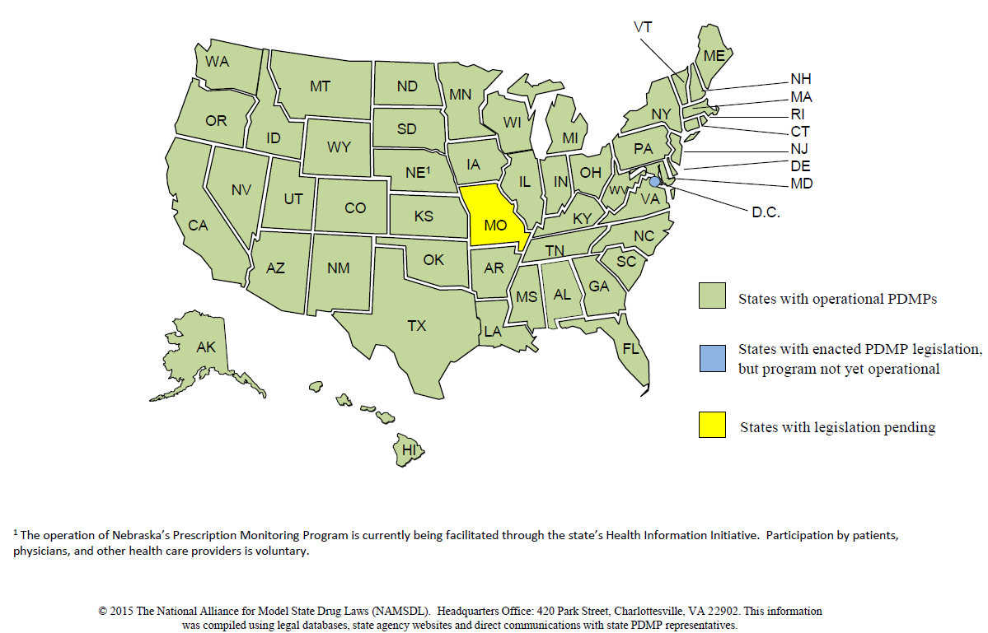
Status of State PMPs

Slide 11
PMPs
Prescribers and Pharmacists
Request
Report
Pharmacies and other dispensers
submit prescription data
Data file
PMP
Regulatory
Boards
Law
Enforcement
Miscellaneous Authorized Requestors

Slide 12
Shortcomings of PMPs
Patients cross state borders
Low utilization by health care
    Impacts workflow
    Separate website
    Registration and login
    Data entry required

Slide 13
Low Utilization of PMPs
Perception of Low Value for Time Invested
Prescribers expect pharmacists to be the watchdog.
Pharmacists expect prescribers to take the initiative.
Hospital prescribers and pharmacists do not see abuse, addiction, or diversion as an in-house issue.
Reports do not include diagnosis or prescriber specialty.

Slide 14
Result Is Low Utilization by Health Care Professionals
If voluntary, utilization is low – only
10-30% of eligible prescribers use PMP.
States did not require health care professionals to utilize the PMP until prescription drug abuse became an epidemic.

Slide 15
How States Are Responding
Interstate Data Sharing
  National Association of Boards of Pharmacy® (NABP®) PMP InterConnect®
  RxCheck
Mandatory Registration
Mandatory Use

Slide 16

Background on NABP Involvement
  NABP’s mission is to support boards of pharmacy and assist other regulators to protect the public health.
  In fall 2010, NABP was approached by several members.
  They requested a low-cost, easy-to-implement, highly enhanced solution for interstate data sharing.

Slide 17
Built using open standards
Cost effective (NABP covers up-front costs.)
Easy to implement
Low maintenance (NABP covers maintenance through June 30, 2016.)
Supports states’ autonomy over PMP data

Slide 18
PMP InterConnect Participation
28 PMPs are actively sharing data today
  Arizona, Arkansas, Colorado, Connecticut, Delaware, Idaho, Illinois, Indiana, Kansas, Kentucky, Louisiana, Michigan, Minnesota, Mississippi, Nevada, New Jersey, New Mexico, North Dakota, Ohio, Oklahoma, Rhode Island, South Carolina, South Dakota, Tennessee, Utah, Virginia, West Virginia, and Wisconsin
Expect 35 PMPs to be connected and sharing data by the end of 2015.

Slide 19
States Sharing Prescription Data With Other States
WA
ME
MT
ND
V
N
OR
MN
T
H
MA
WI
NY
ID
SD
MI
CT
WY
PA
N
RI
IA
J
DE
NE
OH
NV
IL
IN
W
MD
UT
CO
V
VA
CA
KS
MO
KY
DC
NC
TN
AZ
NM
OK
AR
SC
AL
GA
MS
PR
TX
LA
AK
FL
PMP InterConnect state
PMP InterConnect Pending
RxCheck state
Dual Connections
HI
States withMonitoring Programs

Slide 20
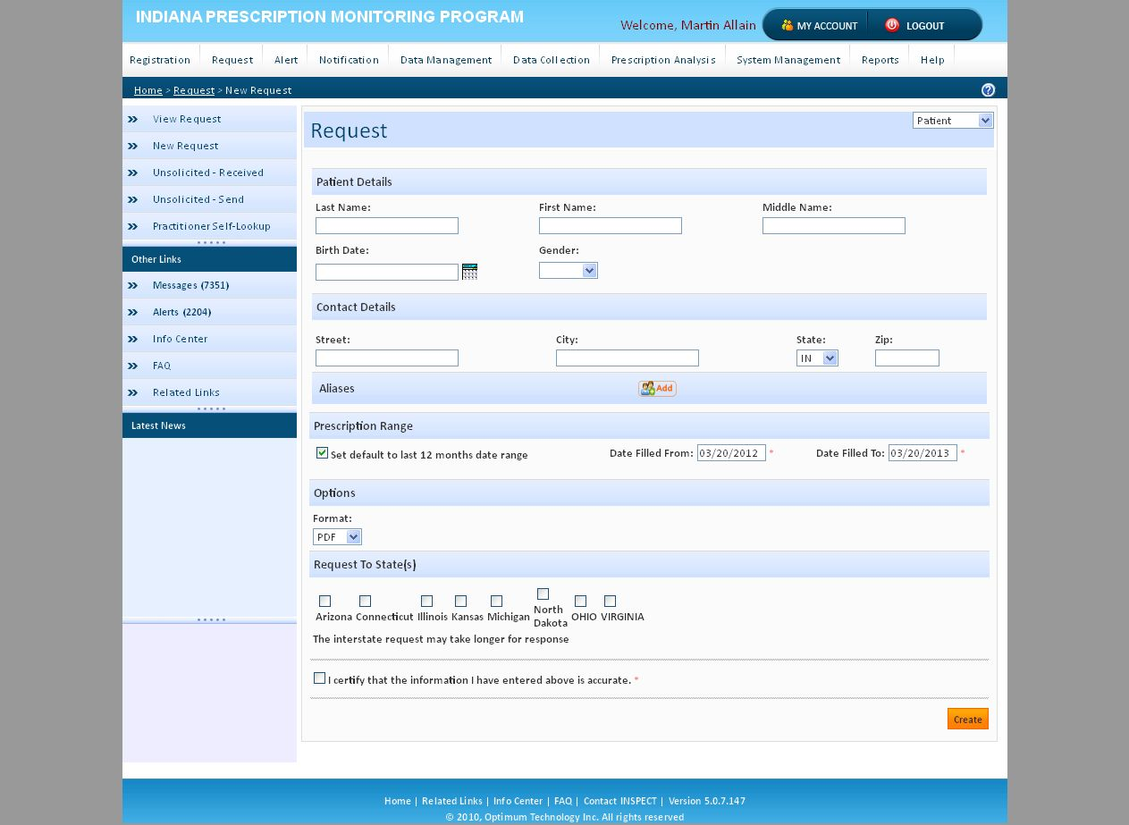
Sample PMP Request Screen for Interstate Search

Slide 21
All protected health information (PHI) is encrypted and not visible to the hub. It is secure and compliant with the Health Insurance Portability and Accountability Act of 1996.
  No protected health information is stored by the hub; it is just a pass-through from one state to the authorized requestor in another state.
It is easy for states to join.
Each state’s rules about access are enforced automatically by the hub.
In July 2011, the system went live. PMP InterConnect is now processing over 1.1 million requests per month, with an average of 6.5 seconds to process a request.

Slide 22
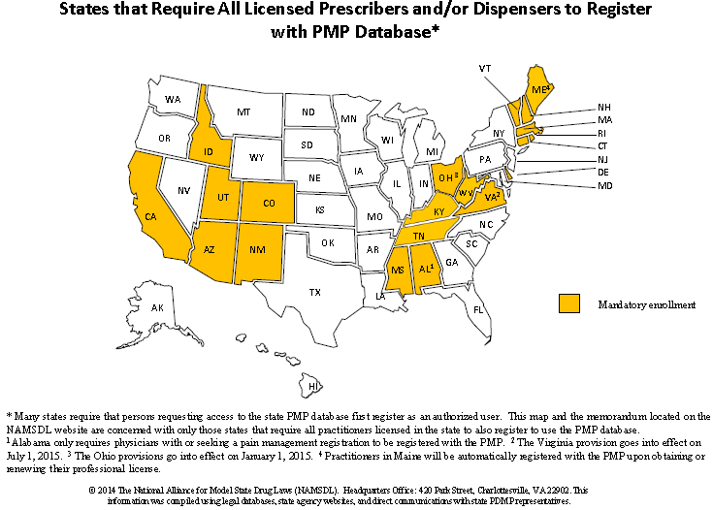

Slide 23
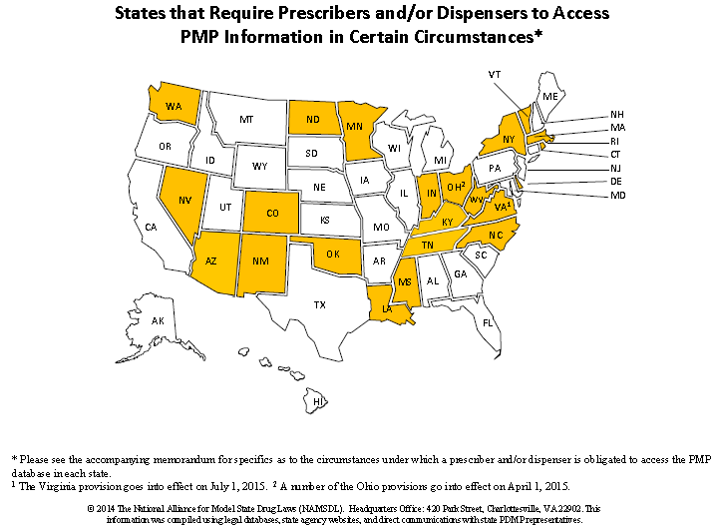

Slide 24
Next Steps to Increase Utilization of PMP Data
Add additional states.
Assist states with legislation (if needed) to allow interstate sharing.
Integrate PMP data into workflow via
  Health information exchanges (HIEs),
  Health care systems or electronic health record vendors, and
  Pharmacy software systems.
Increase efficiency by providing access to analytical tools to automate analysis of PMP reports, eg, NAR_{X}CHECK®.

Slide 25
PMP Data Integrated Into
Health Care Software
_{Physician}
1
Electronic medical record
2
PMP₁
8
4
7
_{Hospital}
1
PMP Gateway
5
Provider Organization
2
NABP
PMP InterConnect
8
4
PMP₂
7
3
5
1
2
4
_{Physician Office}
HIE/network
6
PMP₃
8
7
5
4
2
1
Pharmacy Dispensing Software
5
PMP₄
_{Pharmacist}
7
8
4
5
PMP₅
Request
Response
Data flow is initiated by a patient encounter with a health care provider at step 1.

Slide 26
Benefits of Workflow Integration
Prescriber/pharmacist is credentialed by workplace, instead of by the PMP.
Authentication occurs when logging in to workplace software.
Workplace software populates the data fields for the request.
Delivery of request is automatic.
One-click access.

Slide 27
Workflow Data Integration
No registration
No usernames/passwords
No data entry
No added steps
No delay
Notes:
Use all the reasons Mitre gives on why this is great on the slide – workflow integration and what not
Ease of use
Registering - no more notarized authorization forms, registrations,
Using - user name, passwords
Save times
Ease of Use - Providers with EHR software have the opportunity to have the PDMP data directly integrated into their software.
Prescribers already using the IHIE and/or Regenstrief/Careweb network will have Single Sign-on Access to the PDMP.
Fit with Workflow
Technical Impact
Integration with an HIE will streamline access from EHRs to the PDMP.
Successful HIE integration will provide a model for HIEs nationwide to integrate with their PDMP.

Slide 28
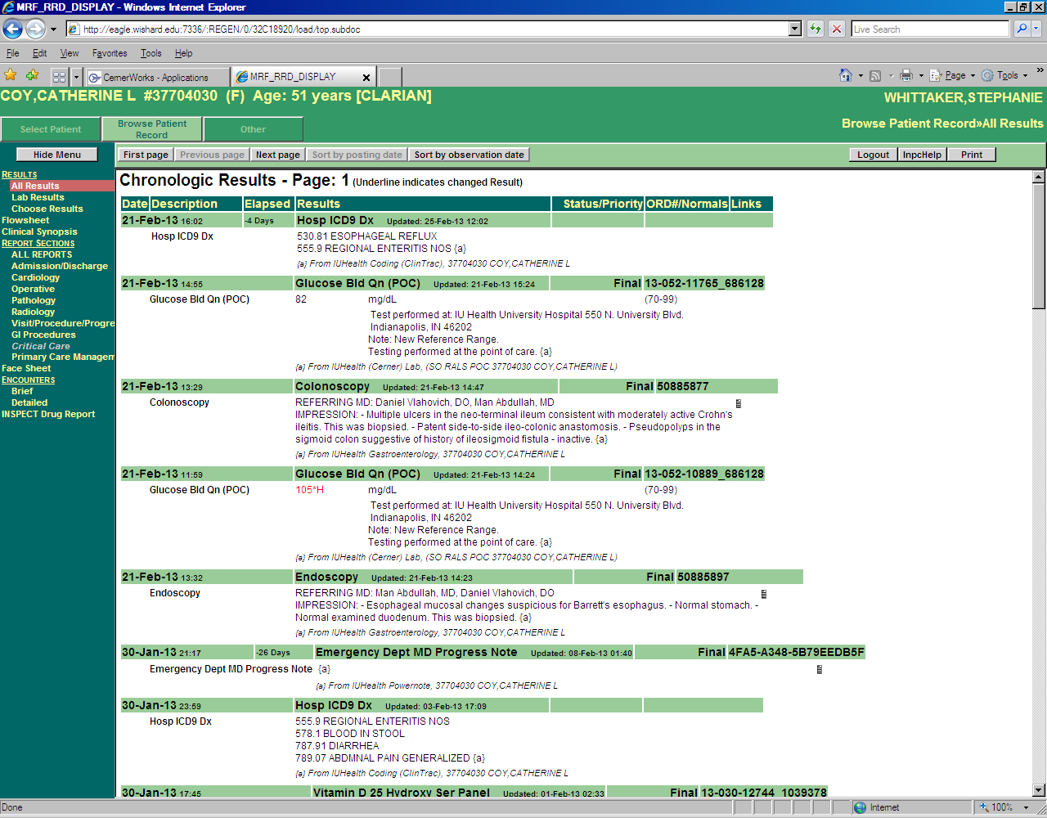
Example of Access to PMP Data –
From Within Electronic Health Record
Direct integration of PMP data through
one-click access

Slide 29

Pilot Teams
EHR/Pharmacy IT | Hub | PDMP
NCPDP 10.6
Epic | OneHealthPort | WA State
Epic | Appriss | New Mexico
Epic | Appriss | Virginia
Epic | Appriss | Wisconsin
DrFirst | Appriss | Arizona
DrFirst | Appriss | Kentucky
NextGen | Appriss | Kentucky (?)
NextGen | Appriss | Arizona
NextGen | Appriss | Wisconsin
PAST | Appriss | Arizona
ASAP Web Services
QS1 | Appriss | Virginia
PAST | Appriss | Arizona
PDX | Appriss | Virginia
Speed Scripts | Appriss | Kentucky
SoftWriters | Appriss | Indiana
Transaction Data Systems | Appriss | Wisconsin (?)
Sprintz Center for Pain | Appriss | TBD
HL7 Standards
Cognosante | Appriss | TBD

Slide 30
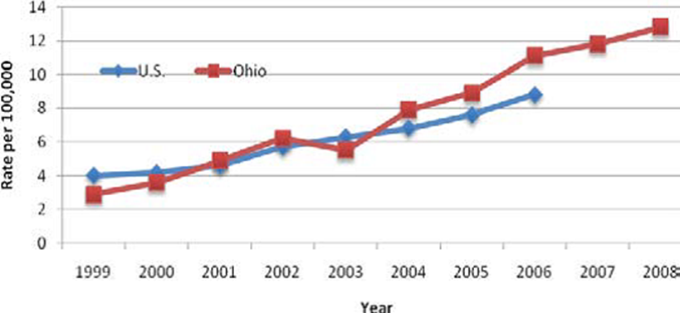
The EPIC Integration Project
Jewish Hospital ED – Mercy Health
The situation in Ohio
  From 2001-2011, Ohio’s death rate due to unintentional drug poisonings increased 440 percent, and the increase in deaths has been driven largely by prescription drug overdoses
  In Ohio, the number of heroin deaths increased approximately 300% from 2007 to 2012, with men aged 25–34 years at highest risk for fatal heroin overdoses
  Ohio’s death rate has grown faster than the national rate, with southern Ohio being affected more than the rest of the state. On average, over 5 people die each day in Ohio due to drug-related poisoning.

Slide 31


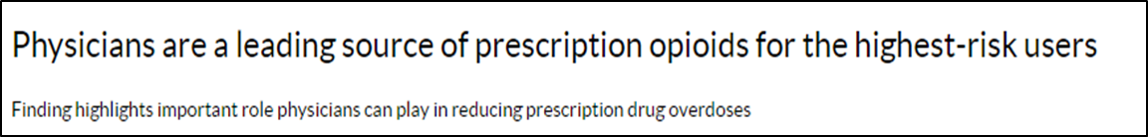
One of the solutions identified
Increase utilization of PDMPs which:
  Decreases doctor shopping
  Reduces diversion of controlled substances
  Improves clinical decision-making
  Supports other efforts to combat the prescription drug abuse epidemic

Slide 32

PDMP Utilization
Definitions of utilization – Important semantics
  Providers with access/who have ever used a PDMP
    One Ohio survey recorded <59% of providers had ever used OARRS – Feldman, 2011
  Providers with frequent use – highly varied definitions
  Time period definition
    Utilization per month
  Rate of screening all patients
    Our original analysis at Jewish showed a screening rate of 3.8%
    We are not nearly as good as we think at identifying patients with misuse/abuse ~60% sensitivity

Slide 33


PDMP Utilization
Importance of utilization
  After review of OARRS – Baehren, 2010 (N=179)
    providers changed the clinical management in 41% (N=74) of cases.
    In cases of altered management
      the majority 61% (N=45) resulted in fewer or no opioid medications prescribed than originally planned
      whereas 39% (N=29) resulted in more opioid medication than previously planned.
  Another study in 2013 (Weiner)
    Providers changed plan to prescribe opioid in 10% of cases
    Limited to conditions where we are more unlikely to prescribe opioid Rx in first place – back pain, dental pain, headache

Slide 34
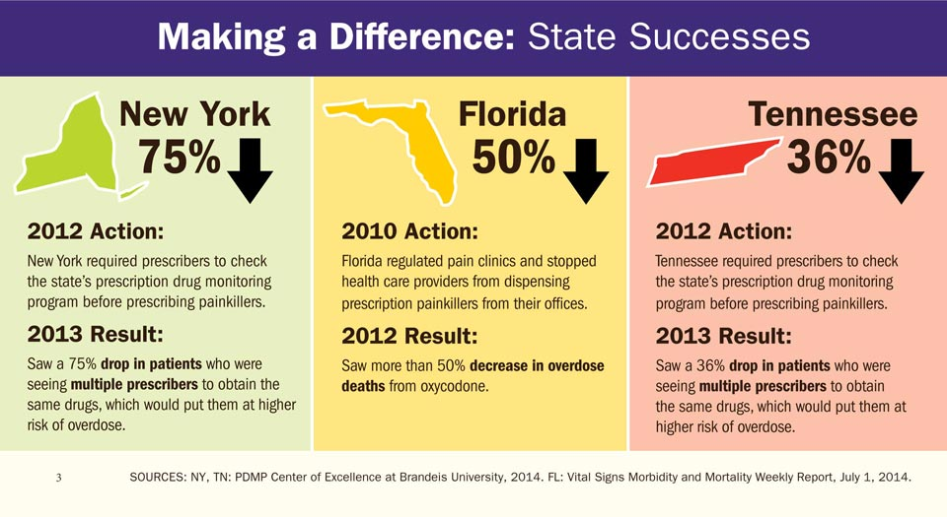

PDMP Utilization

Slide 35
Barriers to Utilization
Access
  Initial registration for PDMP can be cumbersome
  Difficulty accessing and navigating the PDMP (e.g., time to run a patient query)
Insufficient Training and Guidance on how to:
  Interpret findings for use in patient care
  Integrate the PDMP into workflow
  Discuss results with patients

Slide 36

Barriers to Utilization
Patient satisfaction ratings such as Press-Ganey scores
  Some organizations take these scores very seriously (e.g., align clinicians’ financial incentives with such scores)
    Clinicians can perceive that withholding narcotic prescriptions and taking the extra time to review PDMP data can worsen scores
  Two clinician quotes
    “ED wait times are a big driver of customer satisfaction, and something that the hospital keeps an eye on. Thus, it is much easier for a couple of doctors to just write for Vicodin, as opposed to sitting down to discuss the PDMP report with the patient and deal with an ensuing argument”
    “Pain is so subjective so often you just have to give out narcotics when the patient states they are 10/10 pain. But the environment that you work in makes a difference. I have worked in settings where the Press-Ganey scores are more important than patient safety or even staff safety”

Slide 37
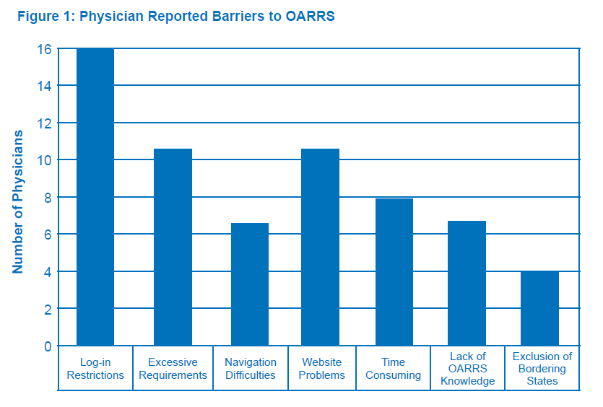
Barriers Reported by Primary Care

Slide 38
Goals of EMR integration
Increase Utilization
  Improve the information delivery to the clinician at the point of care
  Increase the quality of information
    OARRS was, at the time, mostly a list of prescriptions and providers
    No clinical decision support
Reduce Barriers
  Focus on “Click Count”
    Guiding theory was that if it was more than one or two, it wouldn’t be used
    Not absolutely necessary for workflow

Slide 39
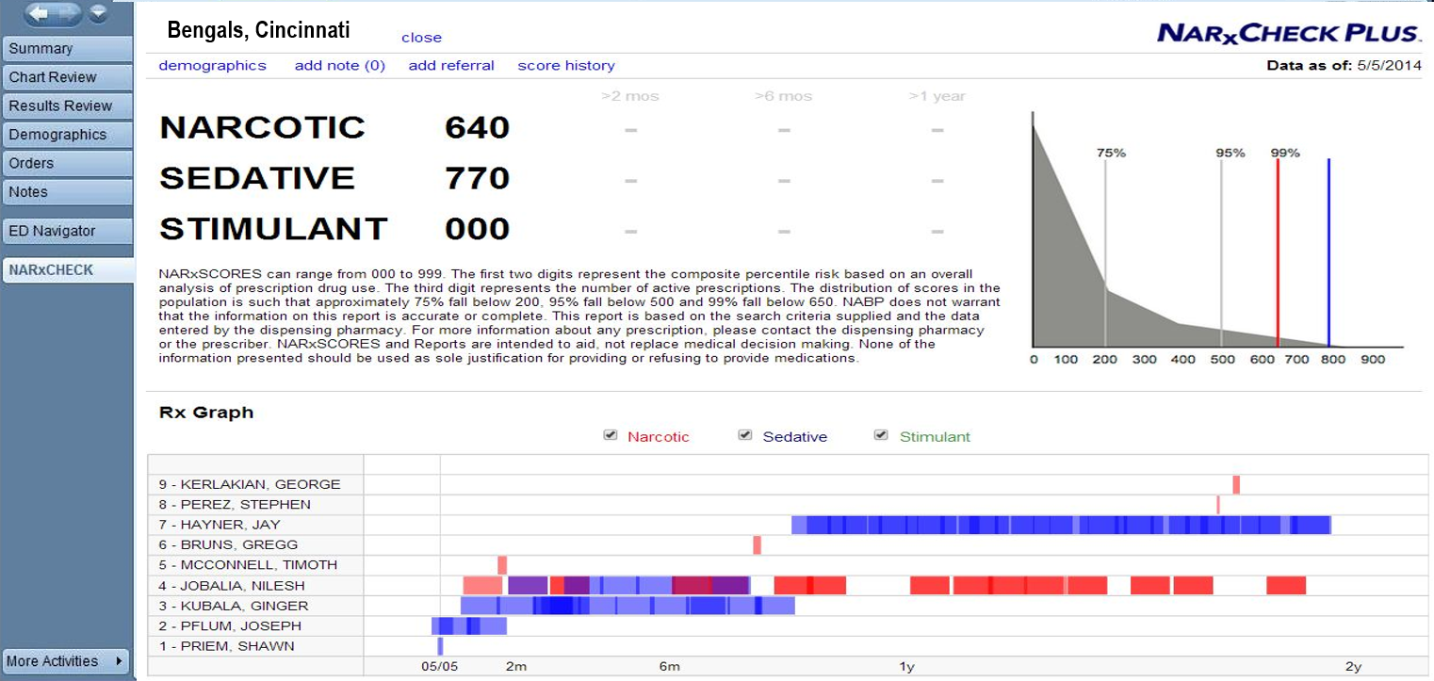
Example of Report

Slide 40
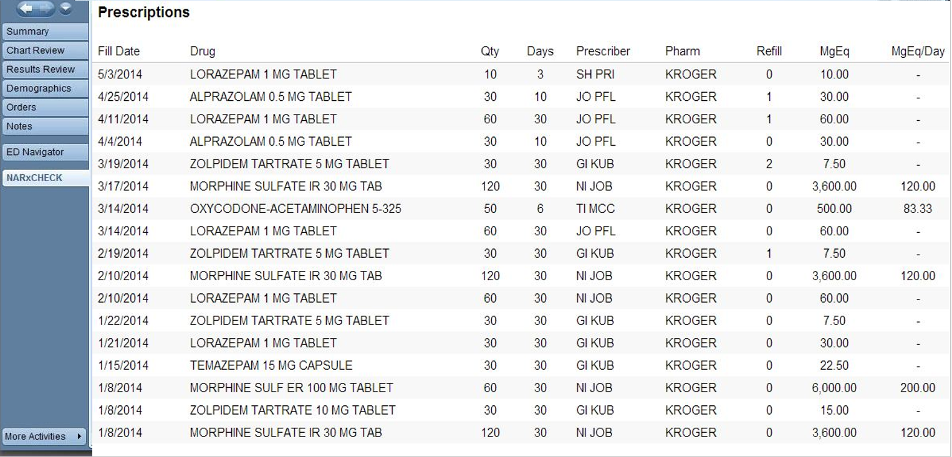
Example of Report

Slide 41
Summary Data from May 5, 2014 to October 5, 2014
12,806 patients scored
9,594 unique patients scored
1,580 logins to NARxCHECK system
1,166 NARxCHECK reports requested by end users
150 resubmitted reports
748 unique patients had NARxCHECK report requested by end user
65 unique end users selected the NARxCHECK report

Slide 42
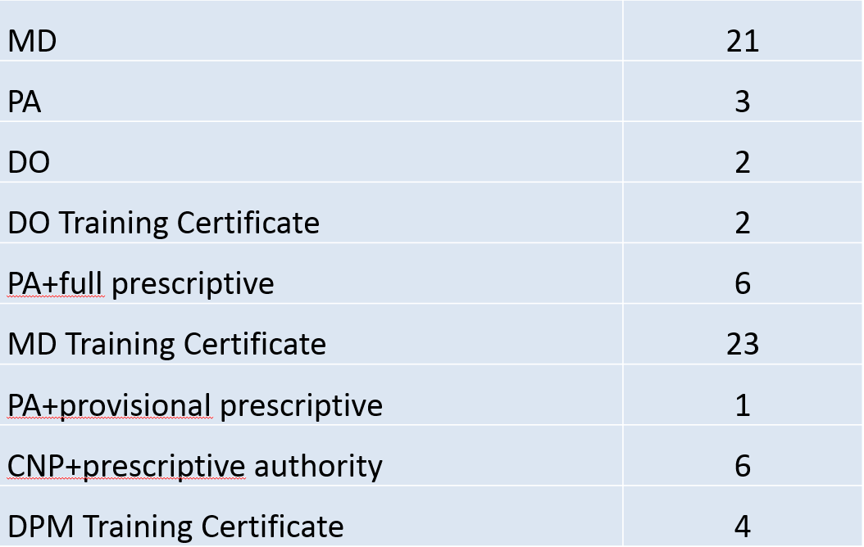
Our Prescribers

Slide 43
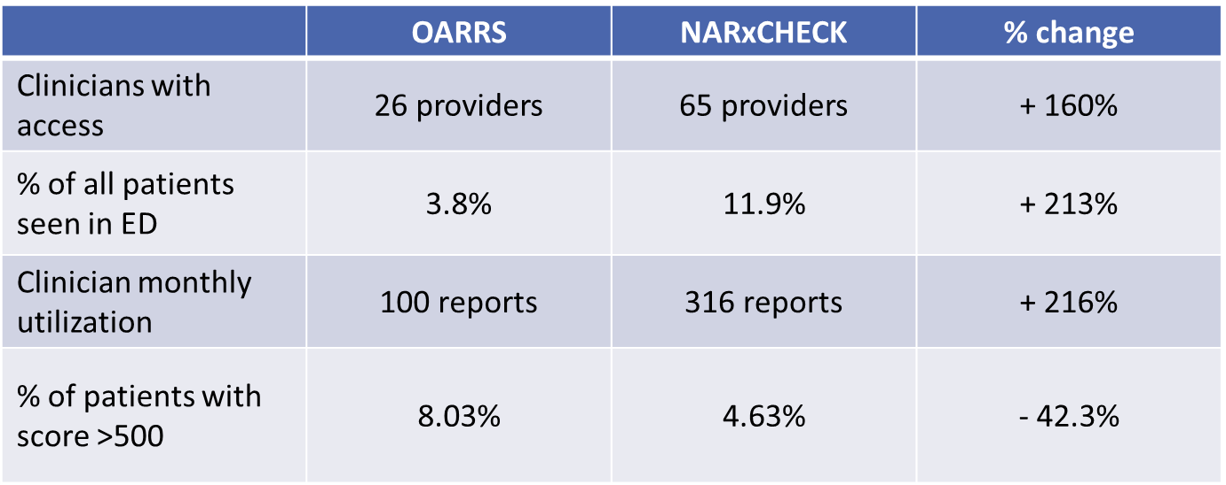
Outcomes
Initial analysis shows:
  Clinician access increased over 150%
  For all patients visits, the rate of PDMP utilization increased over 200%
  Clinician utilization increased ~ 3 fold on average per month
  Decrease in patients with a score > 500 = 42.3%

Slide 44
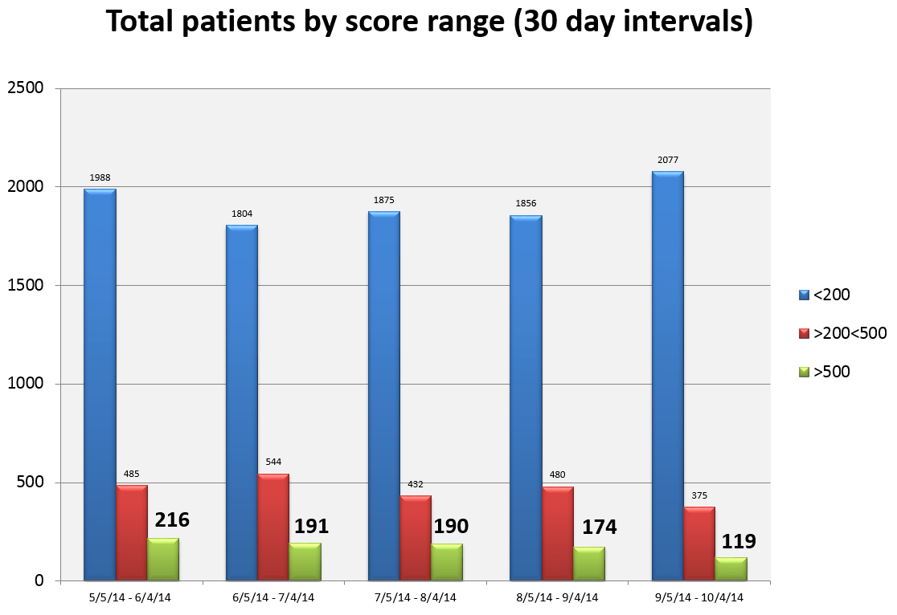

Slide 45
Impact
Substantially increased utilization – no matter how you define it
Significant decrease in high utilizer scores
Evaluation underway to determine decreased prescriptions for controlled substances
  Preliminary data looks promising

Slide 46
Future State
On site controlled substance administration record integration
Mandatory use for every prescriber, every time
  Seamless EMR integration
  Auto-generated score/report/flag when attempting to e-prescribe controlled substances
    Unsolicited reports
  Utilization as a clinical support tool

Slide 47
Contact information
Shawn A. Ryan, MD, MBA
  Assistant Professor, Dept. of Emergency Medicine, University of Cincinnati
  Chair of Quality & Patient Safety, Jewish Hospital-Mercy Health Partners
  e-mail: shawn.ryan@uc.edu
Danna Droz, JD, RPh
  PMP Liaison, National Association of Boards of Pharmacy.
  e-mail: ddroz@nabpnet

Slide 48
Improving Utilization of PDMPs
National Rx Drug Abuse Summit
April 7, 2015

Slide 49
Disclosure Statement
Chris Baumgartner, BS, has disclosed no relevant, real or apparent personal or professional financial relationships with proprietary entities that produce health care goods and services.

Slide 50
Learning Objectives
Describe current practices in interstate sharing of PDMP data.
Investigate strategies states are using to integrate PDMP data with health care records.
Outline the components and results of Washington’s program to provide healthcare organizations with seamless access to PDMP data
Identify best practices in integration and interoperability that participants can implement in their states.

Slide 51
Brief Overview of the WA HIE
Washington State HITech grant dollars were used to fund a statewide health information exchange.
  OneHealthPort managed the vendor selection process and designed the HIE model based on community/constituent input
  OHP HIE is an “exchange” model – no central repository
  OHP HIE can leverage many large existing repositories (EPIC, other EHRs, state agency systems, etc.)
  OHP HIE provides secure, trusted trading options
    Hosted central web services
    Central meeting point for secure connections
    Leveraging and promoting data standards

Slide 52
Key Issues to Address
How do we track requests down to the individual user?
How do you account for the data sharing agreements with trading partners?
How do you address an ADT request with the need to have the request come from an authorized user?
What data standard to use?

Slide 53

Tracking Requests to Each User
Access to the PMP data is provided via the Health Information Exchange (HIE) to:
  Licensed practitioners (valid current registration with the online PMP system)
  Making a secure query from a health information system connected to the HIE
  The user’s PMP username is passed as part of the query so any HIE request is then accounted for in the user’s audit log
Notes:
A key issue with using our HIE is that our law and rules provide access to providers and not facilities or health systems. Legal felt there was a need to still track in our audit log who the provider was that made the query

Slide 54
Data Sharing Agreements
No one liked the idea of having to have a DSA with each hospital, pharmacy, etc…
  DOH had an agreement already with OHP for connecting to our data systems
  OHP has an agreement all trading partners sign.
  So we put into the OHP trading partner agreement specific PMP language they have to follow

Slide 55
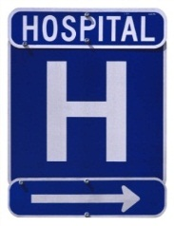
Admission, Discharge, Transfer (ADT)
Many entities would like to send an ADT feed to request PMP data (Ex: patient admitted to the emergency room)
  In these cases you don’t know who the treating provider will be for the request
  So we have these requests sent via a Medical Director who is responsible for each patient’s medical care (to meet our statute)

Slide 56
PMP Data Standards
OneHealthPort & DOH were “stakeholder” participants in the earlier S&I workgroup evaluating PMP standards.
Concurrently, the WA State DOH came to OHP for assistance in moving forward their SAMHSA grant for connecting EHRs to the State PMP
WA DOH, their vendor (HID), and OHP jointly evaluated options with the standards recommendations in mind and moved forward with a solution for interoperability
  Use NCPDP for the data standard and PMIX for transport/security between HID & OHP
  Trading partners use NCPDP and their own preference for transport/security

Slide 57

PMP to HIE to EHR
The response provided from the PMP database via the HIE is:
A real-time transaction based on the authentication of the requestor’s license (pre-registration of the user in the online PMP system) and…
A match of the patient record requested
The request and response utilize the NCPDP Script standard for medication history.
  OHP HIE is utilizing the SCRIPT Standard Implementation Guide v2Ø13Ø12.
  Working to translate to version 10.6 (used by certified EHRs)

Slide 58
Connection Pre-Requirements
Pre-requirements
  Requestors of medication history from the DOH PMP repository have registered in the Prescription Review service online at http://www.wapmp.org/practitioner/pharmacist/.
  Any organization planning to automate the queries can request to use the license of a Medical Director and must contact the Department of Health PMP program director for education and information about the implications for that practitioner before implementation.

Slide 59
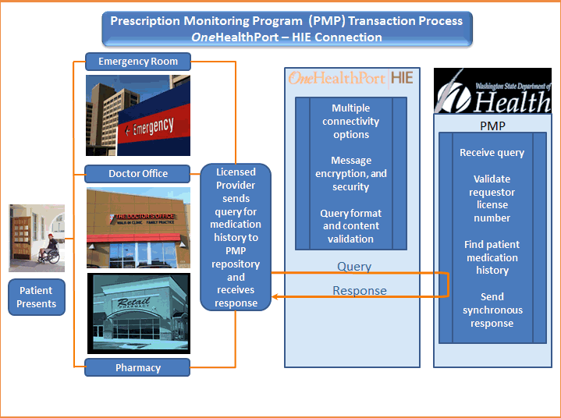
Flow Diagram

Slide 60
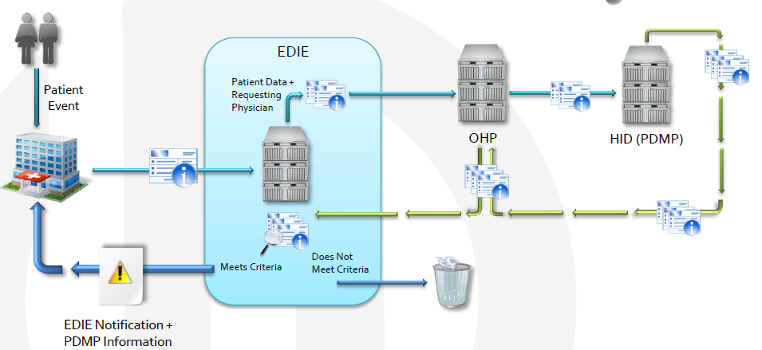
Emergency Department Information Exchange (EDIE)

Slide 61
PMP Criteria for EDIE
If ED visit criteria is met PMP report is provided
PMP Specific Criteria:
  > 3 prescribers in 12 months
  > 4 CS within 12 months
  > 2 CS within last 40 days
  Any Rx for Methadone, Suboxone, Fentanyl Transdermal, LA Morphine, or LA Oxycodone in the last 6 months
  Any overlapping opioid and benzodiazepines Rx in last 6 months
  > 100 average MED/day in last 40 days

Slide 62
PMP Report from EDIE
Last 10 Rx or 6 month CS Rx listing (whichever is more)
  Date Filled
  Drug Name/Form/Strength
  Quantity
  Provider
  Pharmacy
  MED
*12 month summary
  Number of CS Rx
  Number of C-II Rx
  Total Tablets
  Number of Prescribers
  Number of Pharmacies
  Benzos & Opioids (Y/N)
  Long Acting Opioids (Y/N)
* Planned for Phase II

Slide 63
Current EDIE Status
As of February 19, 2015:
  Collective Medical Technology is tracking 91 hospitals
  45 hospitals have the Medical Director released signed
  49 hospitals have the hospital Memorandum of Understanding signed
  37 hospitals have gone live with their PMP connection

Slide 64
Quote from EDIE End User
"Just as creating a PMP was a game changer in it's relationship to coordinating the care of our most at risk patients in WA State, pushing that information without provider bias, without burdensome hurdles, now pretty much mandates providers be aware of these patient's special needs and risks. It's the next level that all of the nation can learn from."
“Now I get flags on 30-35% of my ED patients instead of 20-25% prior to the PMP push into EDIE. Instead of ‘flag alert burnout’, this is a welcome addition of critical information we as providers all appreciate.”

Slide 65
Challenges/Lessons Learned
PMP legislation that was not forward thinking enough (no HIE, authorizing facilities, etc…)
Different data transmission standards (use of different standards, translation could leave data unencrypted)
Avoiding too many data sharing agreements
Patient Matching (no pick list)
Audit trails (tracking requests by facility or end user)
If you build it, “they” may not necessarily come (MU)
  Many facilities have competing priorities with MU and ICD-10
  The providers love the idea but have to sell it to their administration

Slide 66

PMP & Meaningful Use
Stage 2: Meaningful Use Approval: WA DOH has obtained approval to list the PMP as an official “other specialized registry” in compliance with stage 2 meaningful use
  It is listed as an Eligible Professionals (EP) Menu item
  We feel this will assist trading partners with finding a business reason to connect
DOH and other state agencies are moving towards mandated participation in the state-wide health information exchange (HIE)
  DOH has several health systems that will be accessed via the HIE
  Website: www.doh.wa.gov/healthit

Slide 67

Program Contacts
Staff:
  Chris Baumgartner, Program Director
  Gary Garrety, Operations Manager
  Neal Traven, PMP Epidemiologist
Contact Info:
  Phone: 360.236.4806
  Email: prescriptionmonitoring@doh.wa.gov
  Website: http://www.doh.wa.gov/pmp

Slide 68
PDMP Track:
Improving Utilization of PDMPs
Presenters:
Joe Adams, RPh, President, National Association of Boards of Pharmacy
Danna E. Droz, JD, RPh, Prescription Monitoring Program Liaison, National Association of Boards of Pharmacy
Shawn A. Ryan, MD, MBA, Assistant Professor, Department of Emergency Medicine, University of Cincinnati; Chair, Quality and Patient Safety, Jewish Hospital-Mercy Health Partners
Chris Baumgartner, PMP Director, Washington State Department of Health
Moderator: Karen H. Perry, Co-Founder and Executive Director, Narcotics Overdose Prevention and Education (NOPE) Task Force, and Member, Rx Summit National Advisory Board

