Slide 1



Quick Response Team
One Community’s Response
To The Heroin/Opiate Epidemic
Colerain Township Department of Public Safety
Hamilton County, Ohio

Slide 2
Objectives
Discuss statistical data and scope of epidemic specific to Colerain Township.
Discuss the Quick Response Team (QRT) response model
Discuss the Role of Addiction Services Council of Greater Cincinnati

Slide 3
Objectives
Describe the need for culture change amongst fire, EMS, and law enforcement personnel.
Review the effectiveness of the QRT response model.

Slide 4
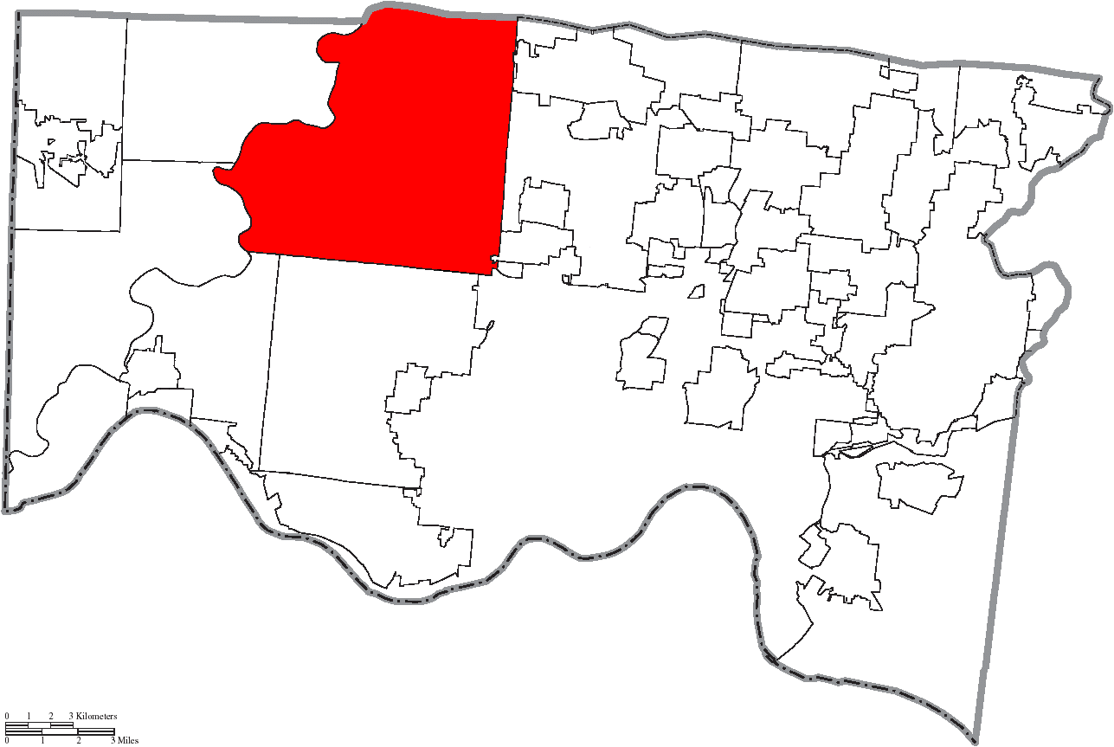
Statistical Data: Painting the Picture
14th Largest Community in the State of Ohio
45 Square Miles
60,000 residents
5 Fire Stations
170 Fire Department Personnel
Fire Department Staffing: 33 personnel
54 Law Enforcement Personnel
6 Beat Officers

Slide 5
Statistical Data: Painting the Picture
  2011 – 51 Overdoses
  2012 – 115 (125% Increase)
  2013 – 116 (0.87% Increase)
  2014 – 141 (22% Increase)
  2015 – 167 (18% Increase)
  2016 – 151* (10% Reduction)
    100 overdoses - September through November 2016 – Carfentinal
  Total Emergency Medical Responses in 2015 - 7520
  Overdose runs = 2.2% of run volume

Slide 6
2015 Overdose Overview
26 (16.6%) incidents of cardiac arrest involved an opiate related overdose.
66 (39.5%) of all overdoses occurred in the home.
100 (59.8%) of all overdoses were Colerain Township residents.

Slide 7
2015 Overdose Overview
Cardiac Arrests
  26 victims were in cardiac arrest at some point during an overdose event.*
  *Does not reflect the number of actual deaths

Slide 8
Community Expectations
Public safety for our communities demands a constant review and adjustment: Leaders cannot rest on the success or failure of past responses
Community members believe their government and public safety leaders are working to address the harm associated with this heroin/opioid epidemic
The reality is…. many communities are waiting and watching…afraid to fail or take a risk

Slide 9
QRT Staffing Model
Six firefighter (FF)/medics; each specially trained as a “Tactical Medic” (TACMED) (SWAT, Military and HRT Experience)
Five Police Officers (SWAT, Military, Narcotics Inv. Experience)
FF/medics received additional training in self defense and OC (chemical irritant) deployment; FF/medics carry OC spray
Policy and procedure created to establish team and TACMED FF/medic selection; Differential Patrol Response; TACMED and Response to Aggressive Behavior for FF/Medics

Slide 10
Maintaining HIPAA Compliance
Follow-up is led by police officers and is facilitated by a commitment to investigate the overdose incidents as criminal acts
The officer brings a paramedic and licensed counselor from the Addiction Services Council of Greater Cincinnati
Discretion is used as a means to introducing the counselor

Slide 11
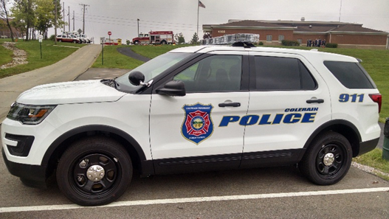
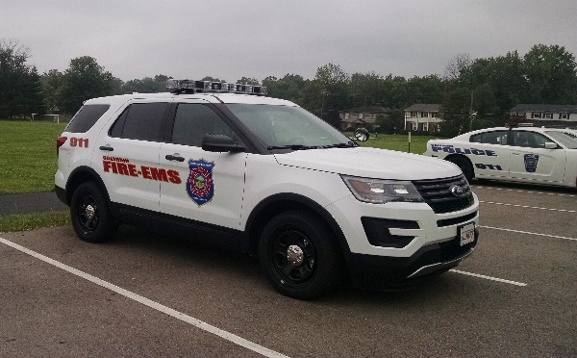

Slide 12
Operational Data
QRT Unit (General Response Model) Operational since July 2015
Nearly 250 “Overdose Follow-up” investigations to date
QRT responded to more than 1,050 incidents, to include medic and fire incidents (Experienced “response time” impact)
  Worked more than 100 shifts

Slide 13
Overdose Follow-Up Data
The QRT and Addiction Services Council professionals conducted 250 investigations. Almost 80% of the persons have entered treatment – in/outpatient
Conducted “door to door” canvassing of “Working to Save Lives” brochure in Township neighborhoods (5 follow-ups)

Slide 14
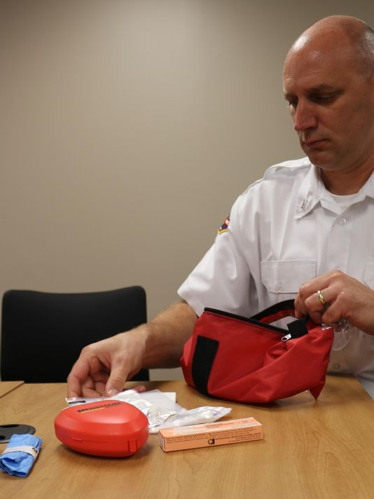
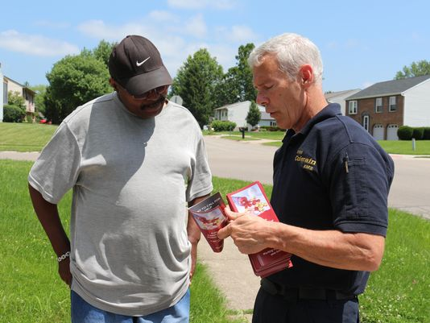
Creating the 360 Solution
Police officers carrying Nasal Narcan
Canvassed “door to door” (Brochure distribution)

Slide 15
Collaborative Assistance
Addiction Services Council of Greater Cincinnati
The QRT effort received $50,000 Naloxone donation to dispense Narcan during follow-up investigation for patients unable to enter treatment immediately
Ohio Department and Hamilton County Department of Public Health provided Narcan doses for distribution by our QRT
Many others!

Slide 16

Social-Ecological Approach: Working across multiple levels for increased
ability to sustain efforts over time and weave into the fabric of the community.

Slide 17













Precontemplation
PROGRESS
NO FIRM COMMITMENT TO ACTION
RELAPSE
Contemplation
Preparation
Action
FIRM COMMITMENT TO ACTION
Maintenance

Slide 18
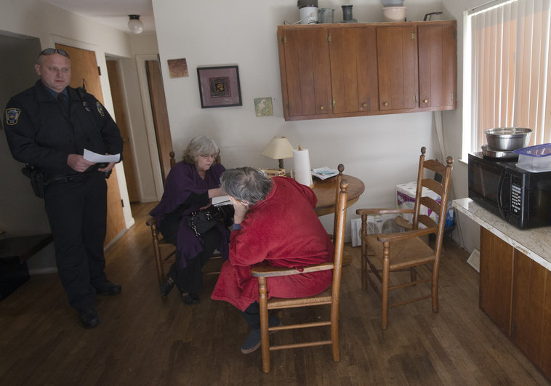
QRT Goal
Move patient towards action
Assist in preparation

Slide 19
The Four Principles of Motivational Interviewing
Principle | Goal
I. Express Empathy | Build rapport
II. Develop Discrepancy | Elicit pros and cons
III. Roll with Resistance | Respect patient autonomy
IV. Support Self-Efficacy | Communicate that patient is capable of change
10

Slide 20

Success Requires Culture Change
Why a culture change?
How do we measure culture change?

Slide 21
Success Requires a Culture Change
August 2014 through September 2016: 600+ Recovery Resource Packets Distributed
Shift from approximately 65% to
100%+ in compliance.

Slide 22
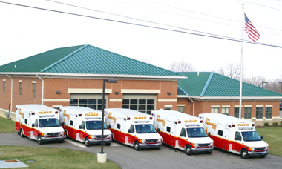
Success Requires a Culture Change
2015: Transport 107 out of 167 overdoses.
Represents a 37% increase
from 2014.

Slide 23
Documented Effectiveness and Successes
Cardiac Arrest Data: January 2015-June 2015
  Total ODs: 96
  Associated Cardiac Arrests: 19 (19.8%)
Cardiac Arrest Data: July 2015-December 2015
  Total ODs: 71
  Associated Cardiac Arrests: 7 (9.8%)

Slide 24
Documented Effectiveness and Successes
Number of responses: January – June 2015
  96
  Associated Cardiac Arrests: 19
Number of responses: January – June 2016
  67
  Associated Cardiac Arrests: 6

Slide 25
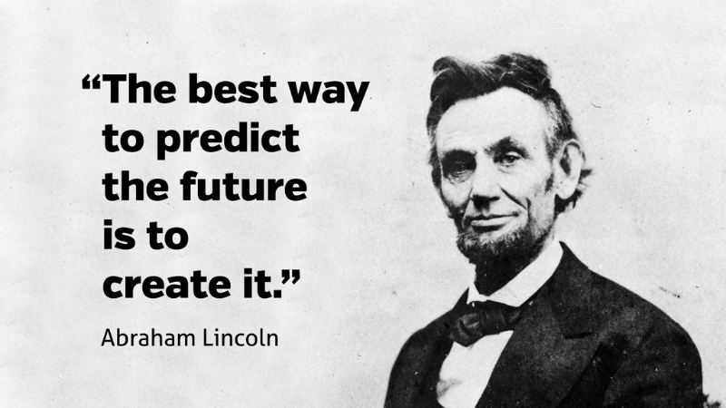
Moving Forward
What are next steps?

Slide 26
Contact Information
Nan Franks, CEO
  nanf@addictionservicescouncil.org
Shana Merrick, MSW, LSW, CDCA
  shanam@addictionservicescouncil.org
Administrator Dan Meloy
  dmeloy@colerain.org
Assistant Chief Will Mueller
  wmueller@colerain.org

Slide 27
Questions

