Slide 1
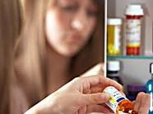
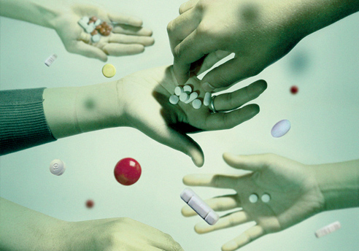
Overdose Suppression Project:
A Comprehensive Response

Slide 2
Three Strategies:
Law Enforcement
Public Awareness
Quantitative Research

Slide 3
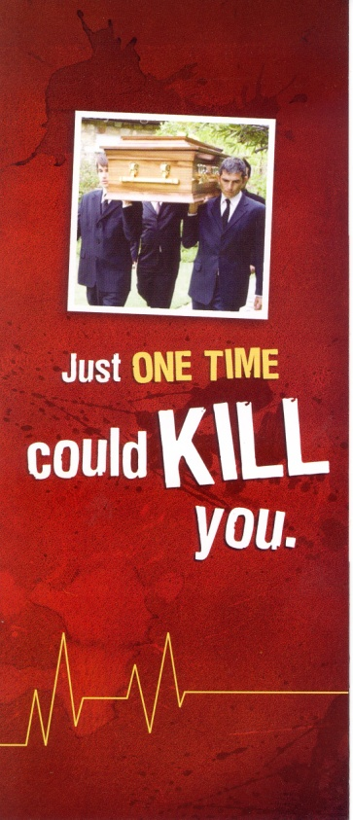
Local Overdose Death Data
247 drug overdose deaths in Palm Beach County in the year 2012
More than Suicides
More than Homicides
More than Fatal Car Accidents
Notes:
Local Overdose Death Data (Use local statistics)
297 overdose deaths in Palm Beach County
More than the number of homicides.
More than the number of suicides
More than the number of automobile related fatalities
Here in Palm Beach County, overdose is fast becoming the leading cause of death. In 2005 there were 220 fatalities from car accidents, that same year; there were 220 drug overdose fatalities in our community.

Slide 4
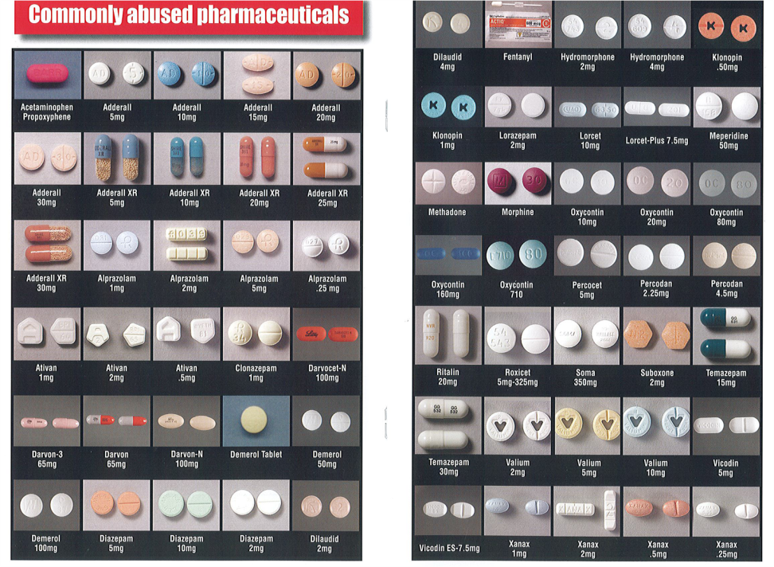
High Risk Drugs
Opiate Pain Medications
Depressants/Sedatives
Illicit drugs including alcohol
Notes:
These are the culprits
Opiate Pain Medications
Depressants/Sedatives
Illicit Drugs including Alcohol
Visit the NOPE website for more information about drugs

Slide 5

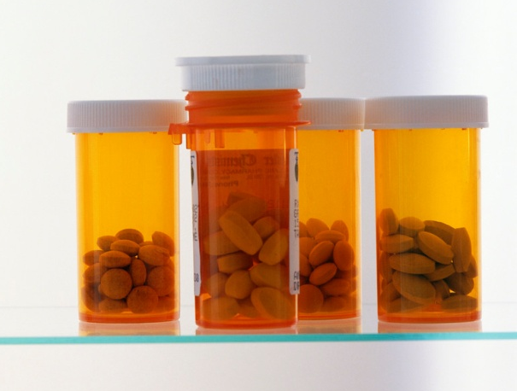
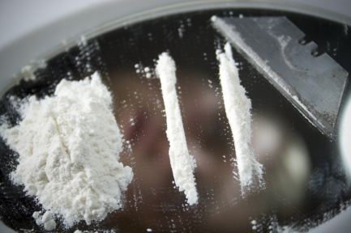
Combining and Mixing Drugs
Multiple contributable drugs found in majority of overdose fatalities
Average of 2.7 drugs found in overdose cases
Notes:
Multiple contributable drugs found in majority of overdose fatalities
Average of 2.7 drugs found in overdose cases

Slide 10
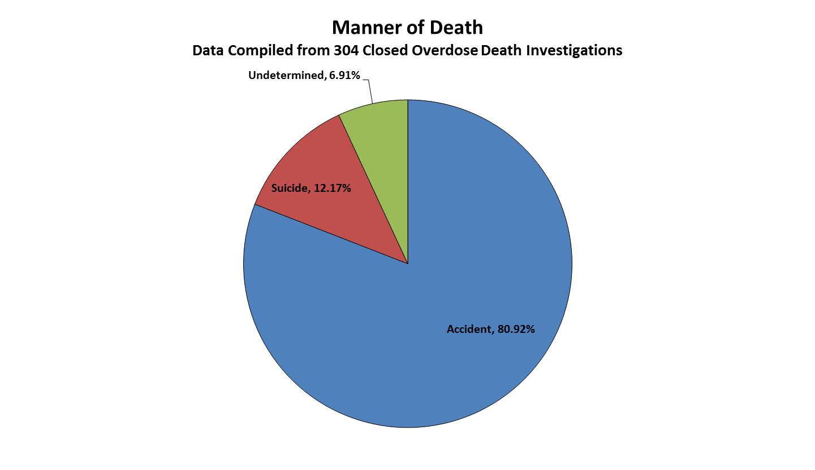

Slide 13
The Critical Points
All Bets Are Off
Addiction is Treatable
Passed Out = Medical Emergency

Slide 14
Recovery Position

Slide 15
911 Good Samaritan Law
893.21 drug-related overdoses; medical assistance; immunity from prosecution.
(1) A person acting in good faith who seeks medical assistance for an individual experiencing a drug-related overdose may not be charged, prosecuted, or penalized pursuant to this chapter for possession of a controlled substance if the evidence for possession of a controlled substance was obtained as a result of the person’s seeking medical assistance.
(2) A person who experiences a drug-related overdose and is in need of medical assistance may not be charged, prosecuted, or penalized pursuant to this chapter for possession of a controlled substance if the evidence for possession of a controlled substance was obtained as a result of the overdose and the need for medical assistance.
(3) Protection in this section from prosecution for possession offenses under this chapter may not be grounds for suppression of evidence in other criminal prosecutions.
This act shall take effect October 1, 2012.

Slide 16
Contact Information:
Detective Gary Martin-Reserve
Violent Crimes Division – Homicide Unit
Palm Beach County Sheriff’s Office
West Palm Beach, Fl 33406
561-688-4058
marting@pbso.org
Or
Gary Martin, Ed.D.
Dean of Students
Lynn University
Boca Raton, Fl 33431
561-237-7157
gmartin@lynn.edu

