Slide 1
Addiction
State Representative Robert Cole Sprague
83rd Ohio House District

Slide 2
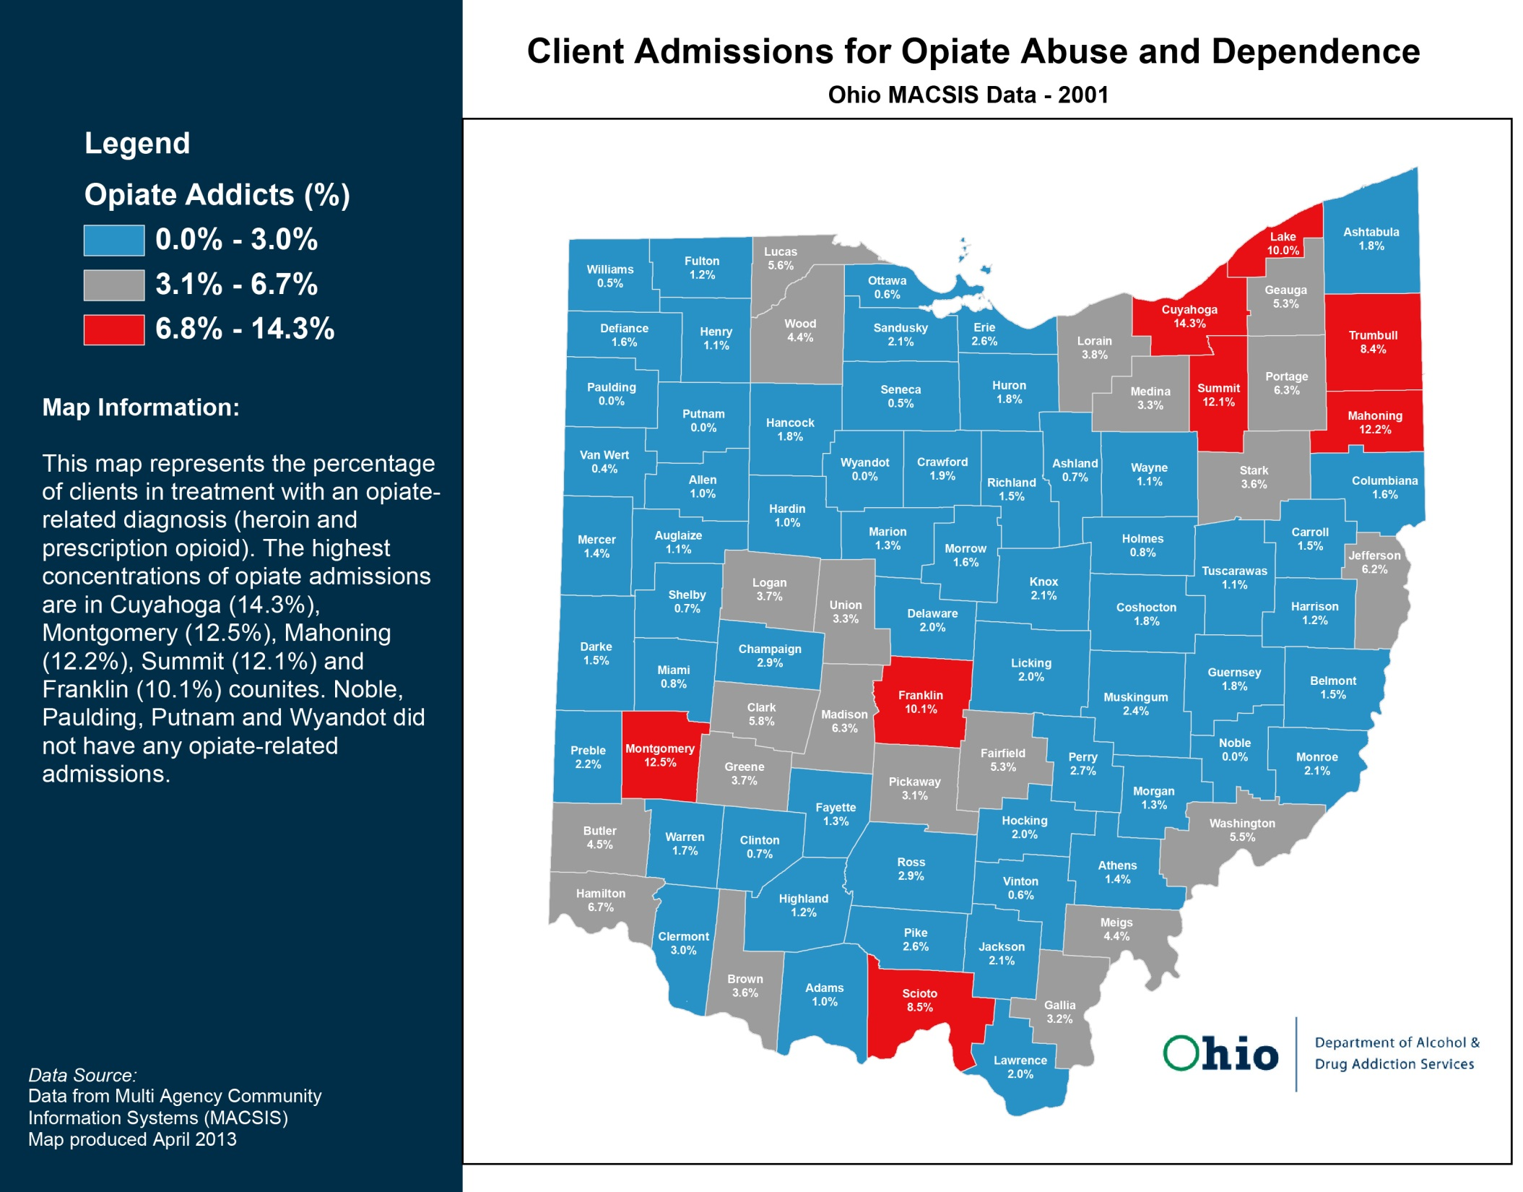


Slide 3
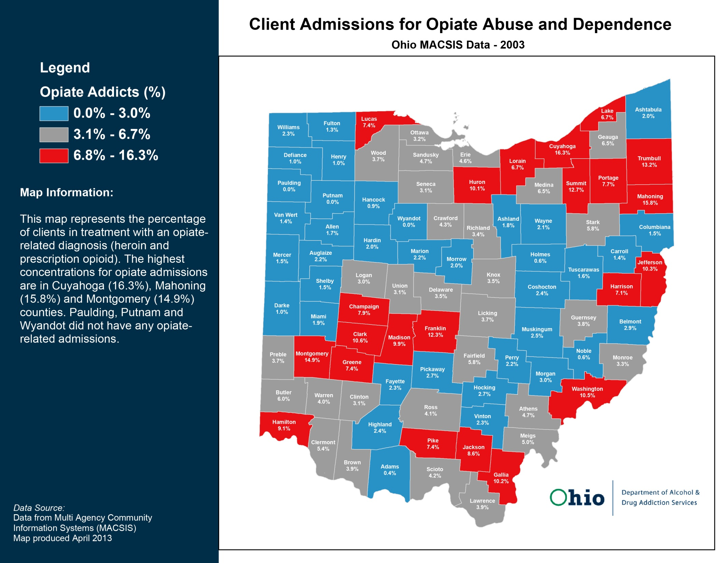

Slide 4
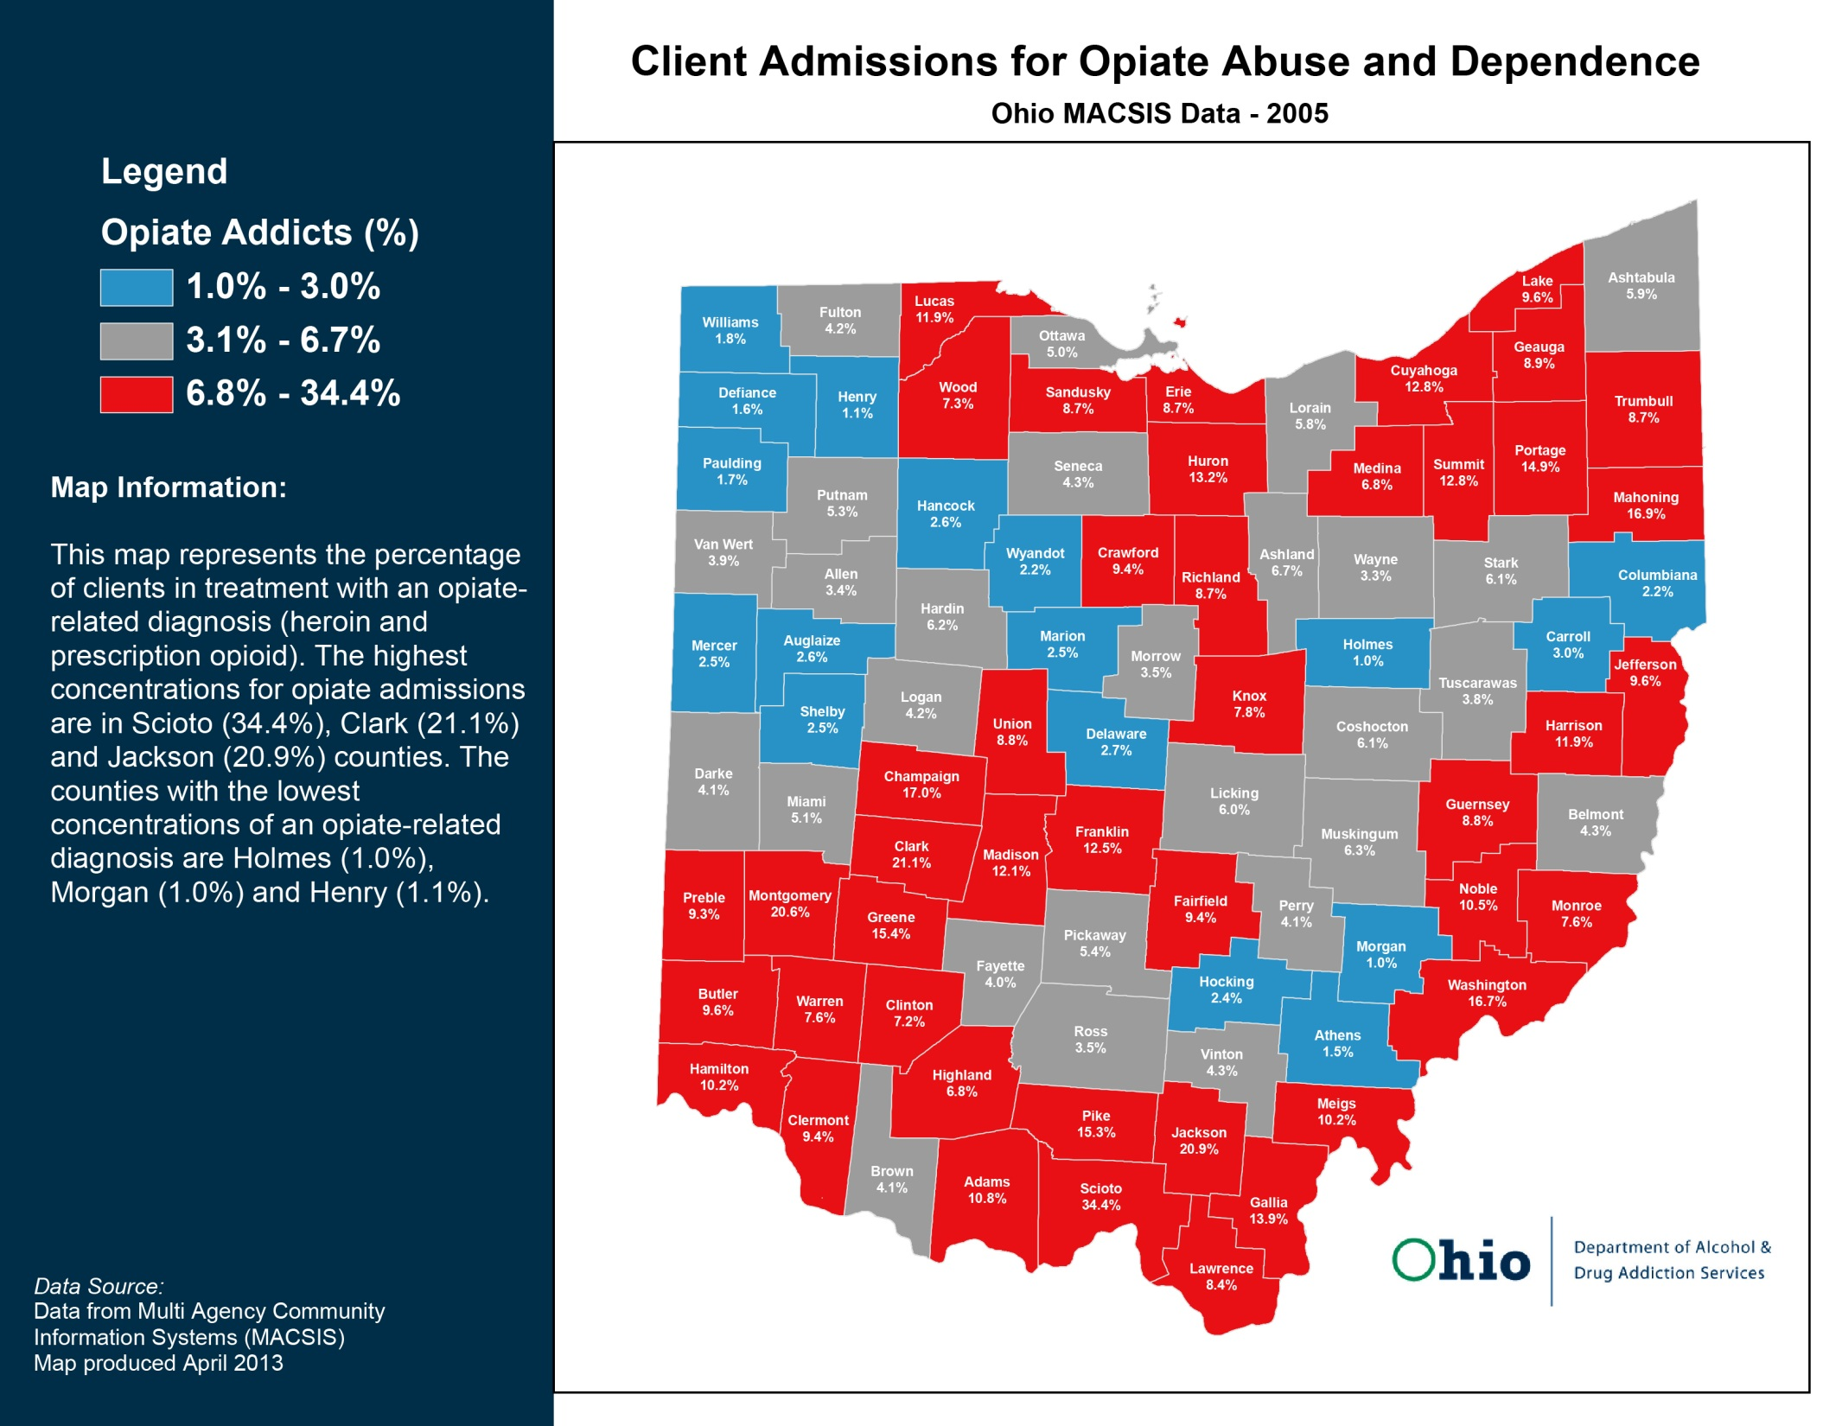

Slide 5
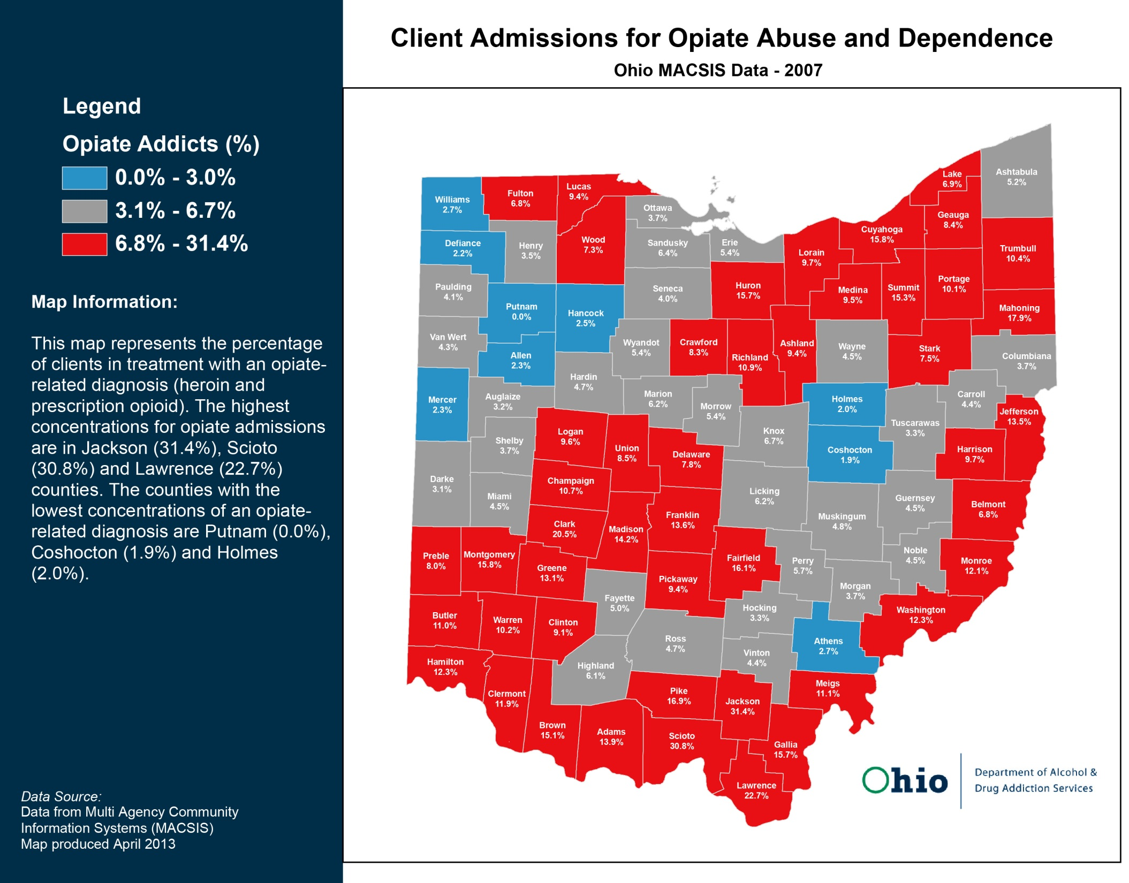

Slide 6
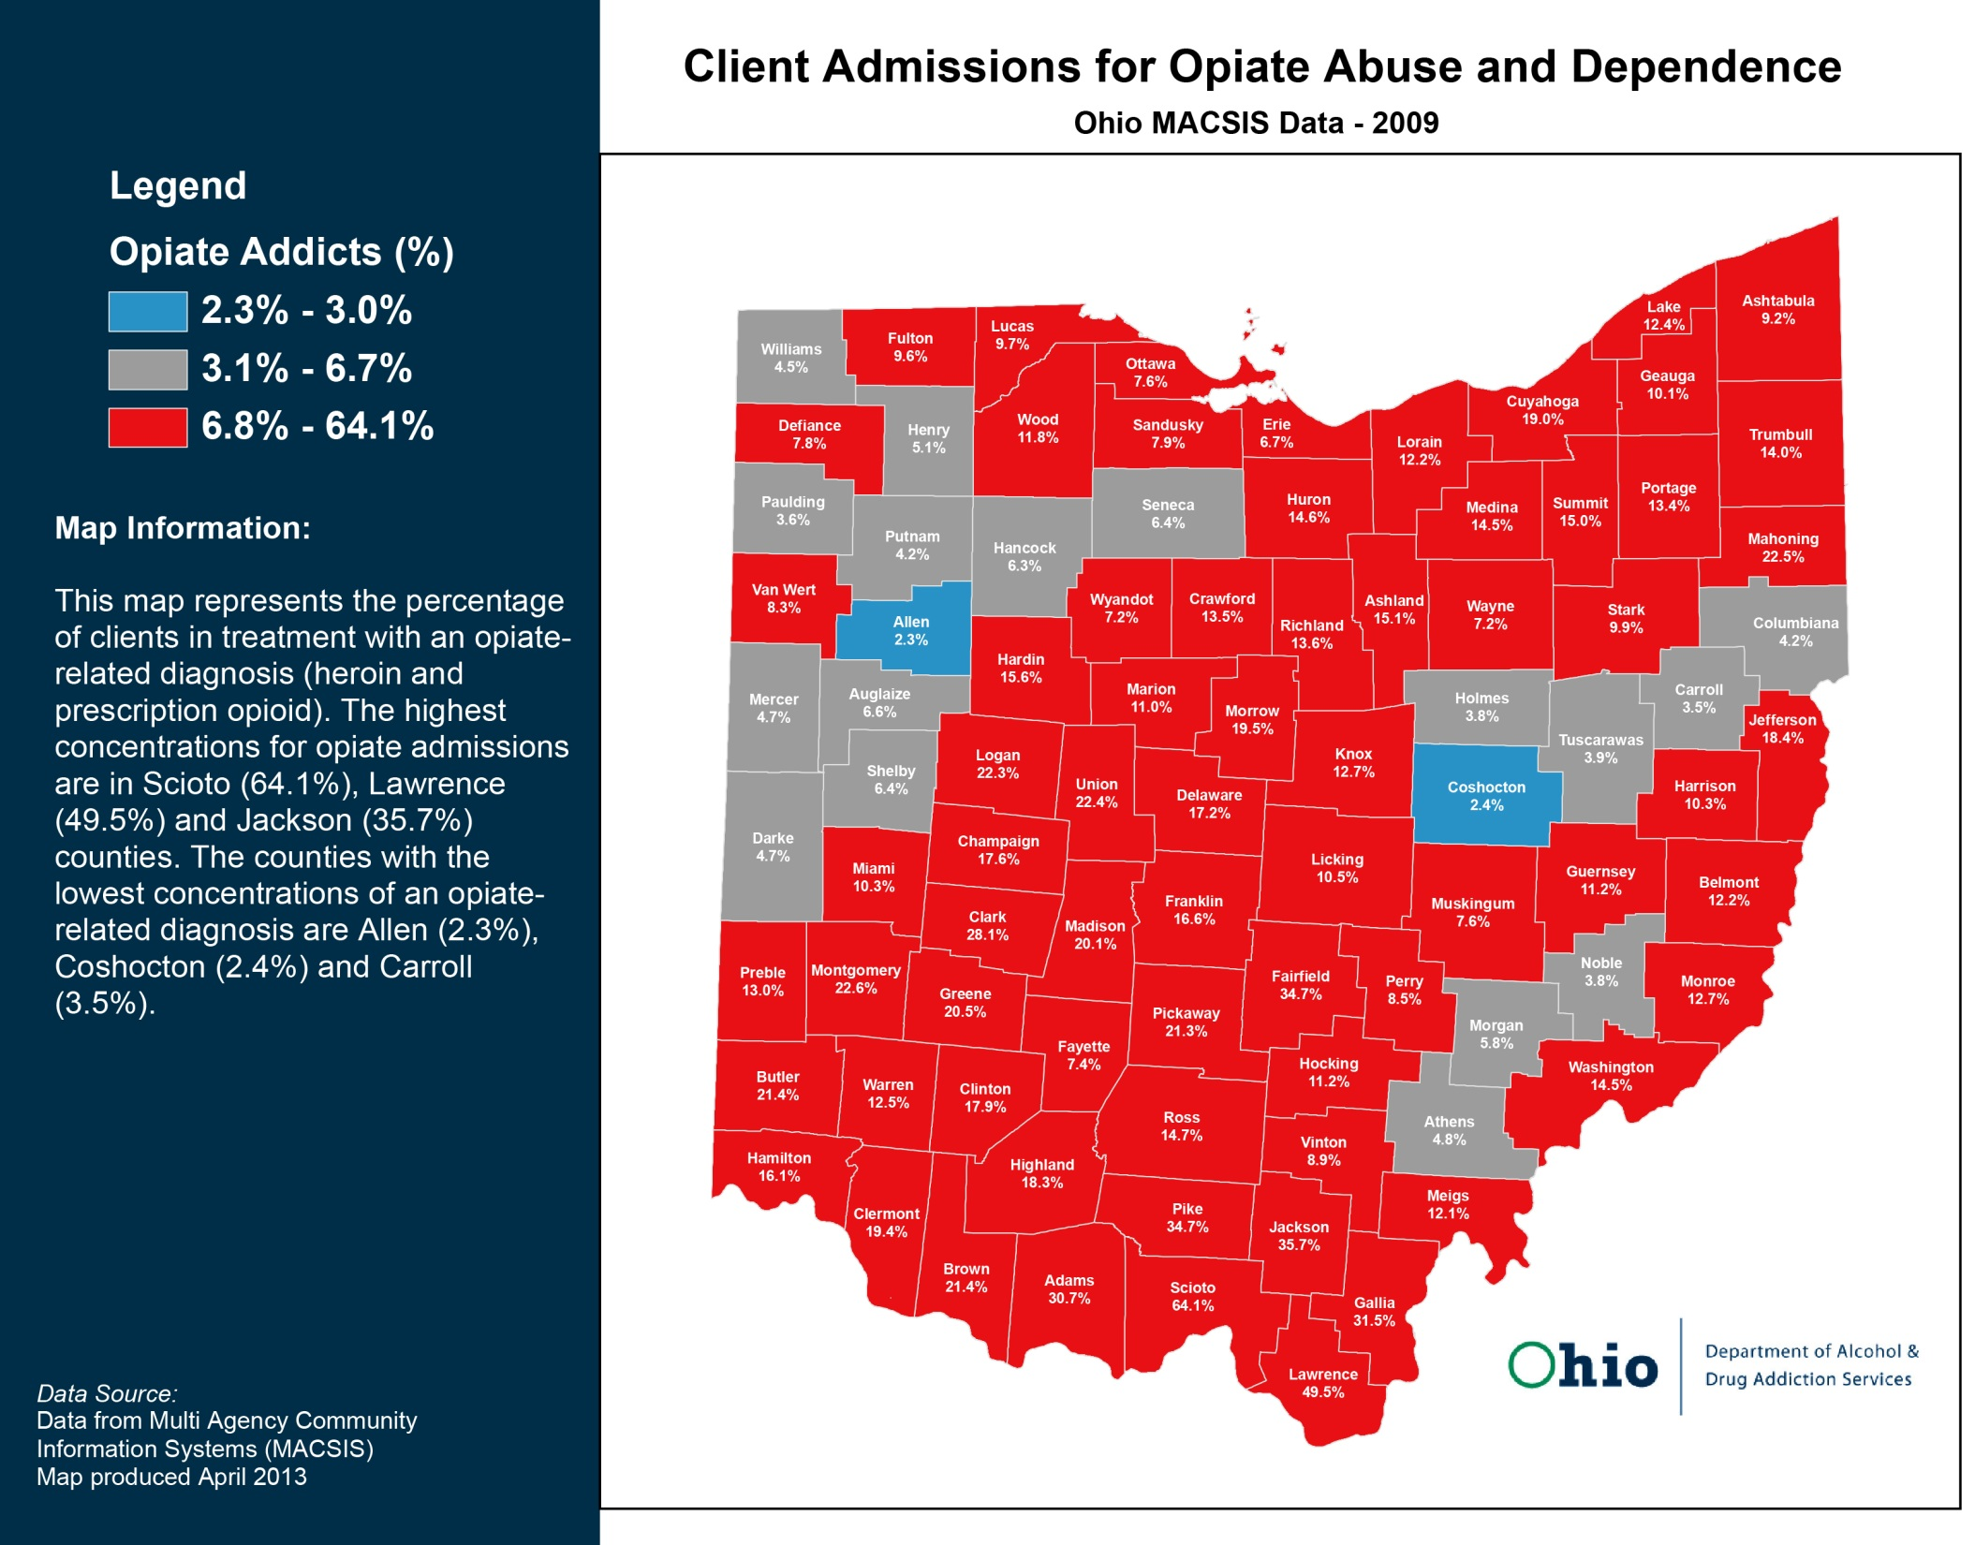

Slide 7
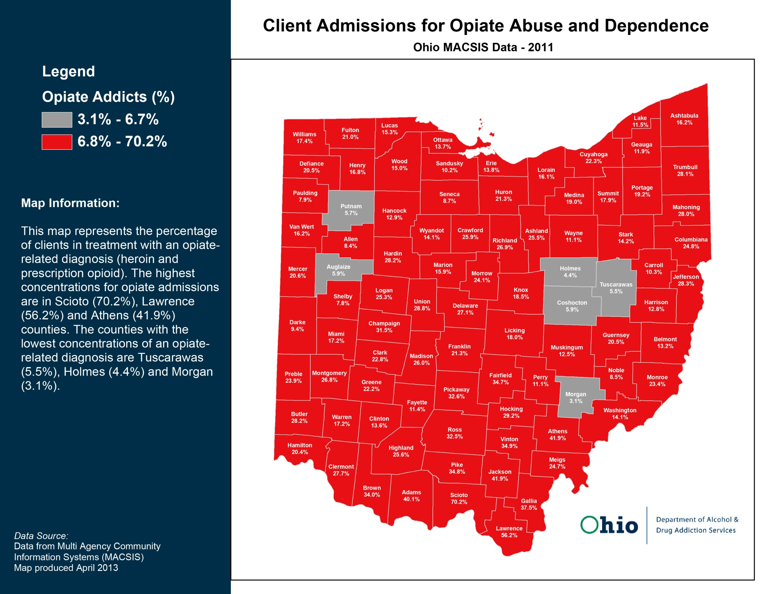

Slide 8
What has caused our current addiction epidemic?
Pain as the Fifth Vital Sign
Intractable Pain Act
Introduction of new pain medications
Marketing strategies
Doctor shopping
Diversion
Pill mills
Street value
Increased prescribing
Perception of prescription medication
Patient satisfaction surveys

Slide 10
Unintentional Overdose Deaths
In 2014, 2,482 Ohioans died from an unintentional drug overdose.
  17.6% increase from 2013 (2,110 deaths)
83rd Ohio House District (2009-2014 averages)
  Hancock County: 10.2 deaths per 100,000 residents
  Hardin County: 15.6 deaths per 100,000 residents
  Logan County: 11.3 deaths per 100,000 residents

Slide 11
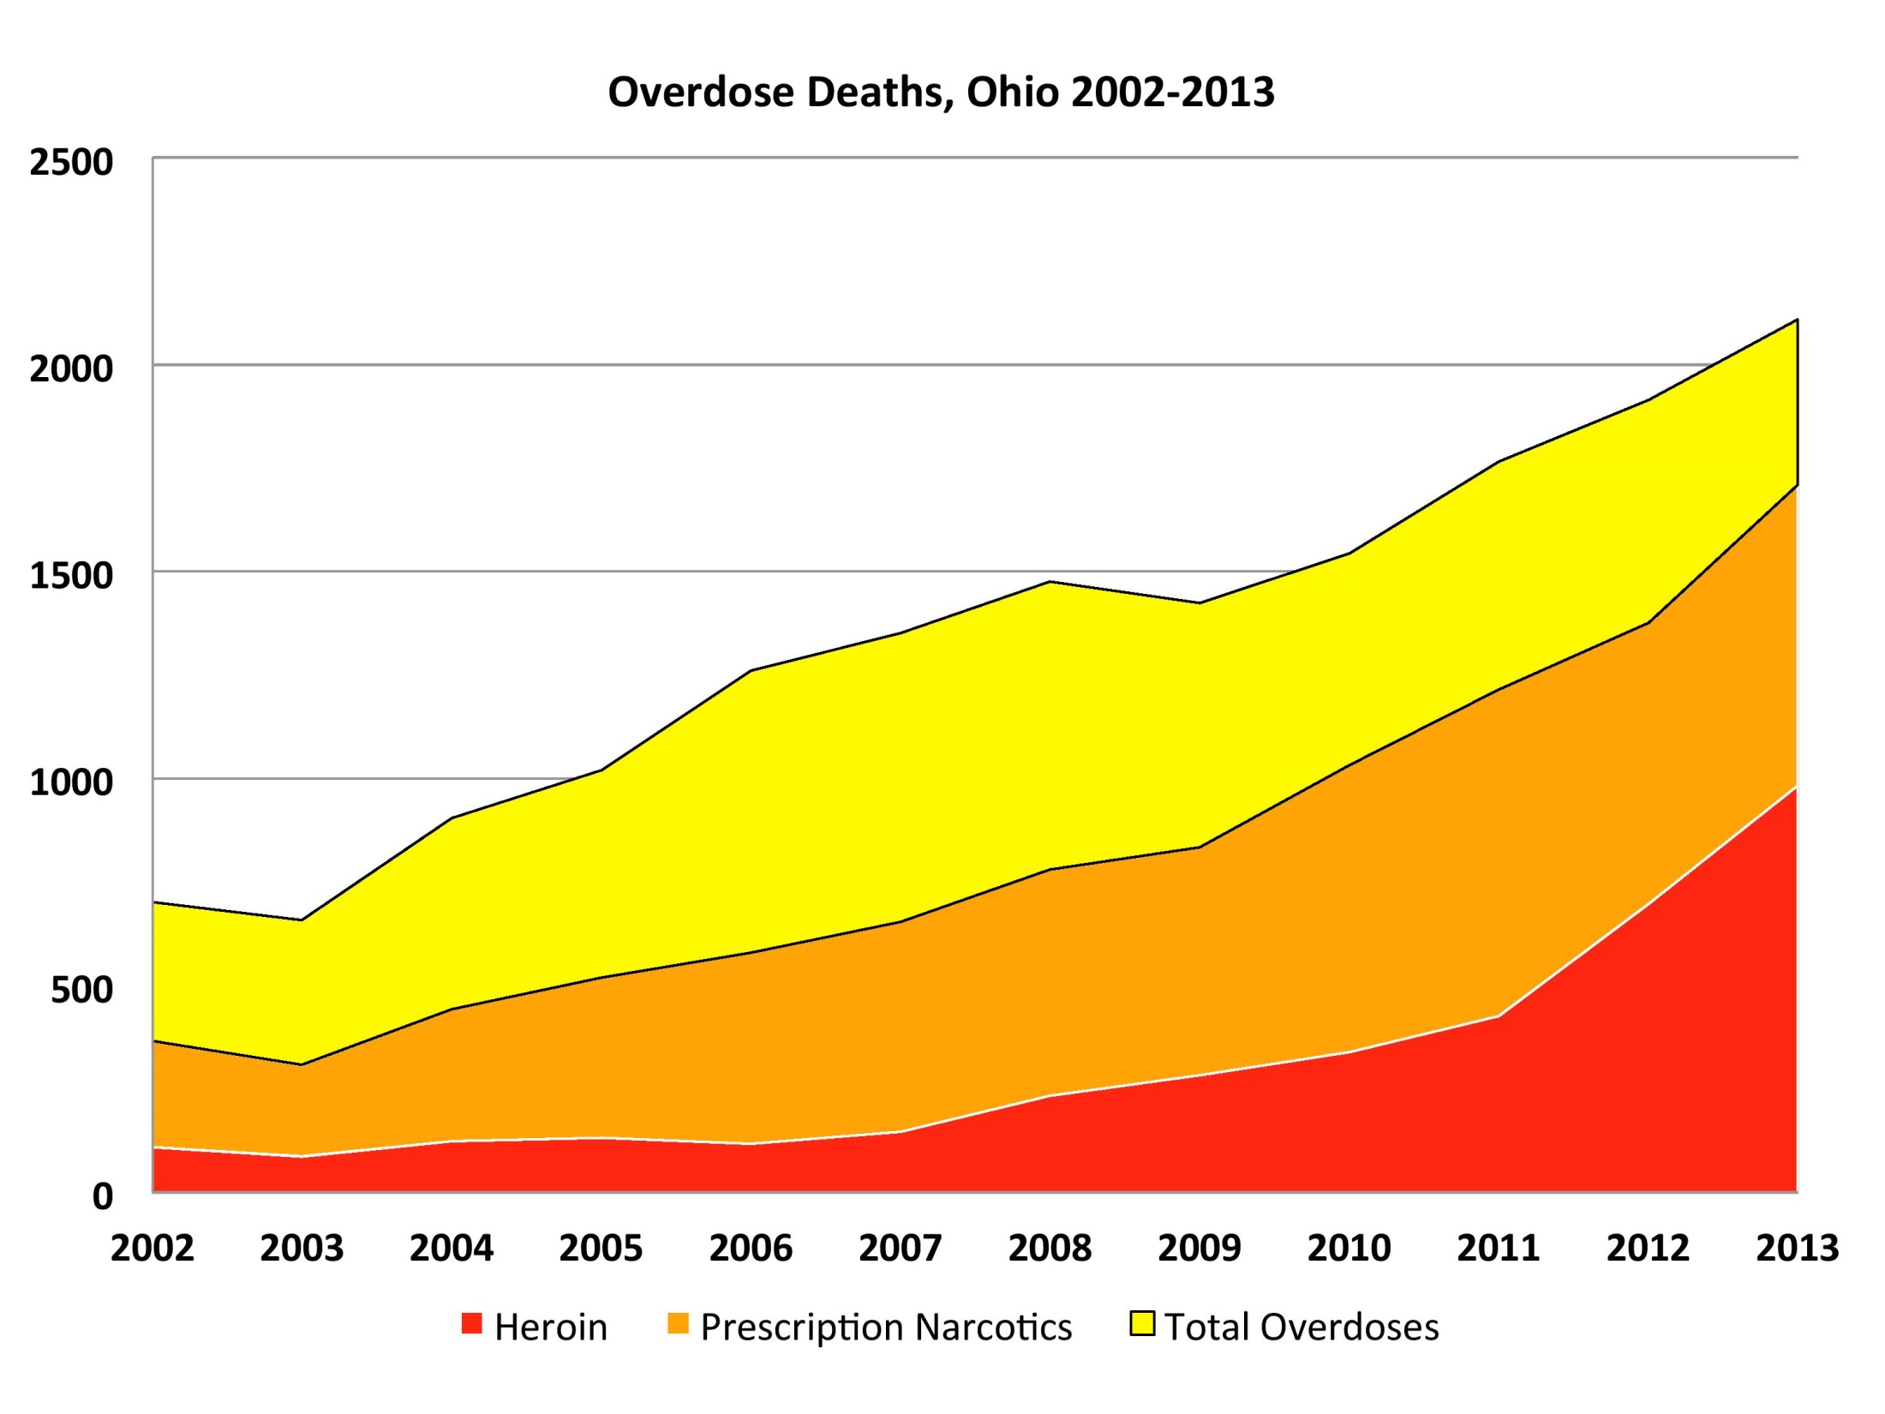

Slide 12
Legislative Approach
Prevent more people from becoming addicted.
Prevent diversion of prescription medication.
Keep people alive.
Improve Ohio’s treatment system.

Slide 13
Recently Enacted or Effective Laws

Slide 14
Awareness Days
House Bill 399 and House Bill 465
(130th General Assembly)
House Bill 399 designated the first Friday of May as “Prescription Drug Abuse Awareness and Education Day.”
House Bill 465 designated the first week of July as “Neonatal Abstinence Syndrome Awareness Week.”

Slide 15
Addiction Education
House Bill 367
(130th General Assembly)
Previously, Ohio law required health classes to cover topics such as nutrition, alcohol abuse, tobacco abuse, general drug abuse, and personal safety.
As part of the health curriculum, the new law requires school districts to include information regarding prescription opioids and heroin.
  Curriculum recommendations have been issued by the Governor’s Cabinet Opiate Action Team.

Slide 16
Pregnant Women
House Bill 394 and Senate Bill 276
(130th General Assembly)
Within these two bills, language was included that increased penalties for illegally providing controlled substances to pregnant women.
  Specifically, for some substances, the new law implements felony charges for corrupting another with drugs and mandatory prison sentences.

Slide 17
Heroin Trafficking
House Bill 171
(131st General Assembly)
This legislation reduced the amount of heroin required for first degree felony possession offenses, putting the figure in line with crack cocaine possession amounts.

Slide 18
Satisfaction Surveys
House Bill Concurrent Resolution 16
(131st General Assembly)
Federally regulated patient satisfaction surveys are linked to hospital rating, reimbursement, and medical professional compensation. These surveys can add pressure on prescribers to prescribe pain medication.
House Concurrent Resolution 16 urges the federal government to revise patient satisfaction surveys and removed questions related to pain.
The federal government is in the process of removing pain-related questions.

Slide 19
Prescribing to Minors
House Bill 314
(130th General Assembly)
Before prescribing an opioid to a minor, House Bill 314 requires prescribers to get consent from a parent or guardian.
  The prescriber does not have to get consent:
    during medical emergencies;
    for surgeries;
    when there is the possibility of a detriment to the minor’s health or safety; and
    if care is rendered in an institutional or residential setting.

Slide 20
Opioid Pill Mills
House Bill 93
(129th General Assembly)
House Bill 93 was signed into law to stop unscrupulous prescribers, close the pill mills, and begin changing how chronic pain is treated.
  Pain management clinics have to be licensed by the State Board of Pharmacy.
  Laws were revised related to the treatment of chronic pain.
  The Ohio Automatic Prescription Reporting System (OARRS) was improved by allowing:
    data to be kept for a longer period of time in an aggregate manner;
    the Board of Pharmacy to pursue a criminal case if the system is used improperly; and
    regulatory boards of the prescribers to write rules for utilizing OARRS.

Slide 21
Buprenorphine Mills
House Bill 367 and House Bill 4
(130th and 131st General Assemblies)
Due to loopholes in law, prescribers were using the disguise of addiction treatment, while improperly using buprenorphine, to exacerbate the addiction epidemic. Buprenorphine is a partial agonist used to treat opioid addiction, but it can be abused.
In addition to addiction education language, House Bill 367, along with House Bill 4, contained language that provides greater oversight of buprenorphine providers. With similarities to legislation that was used to combat opioid pill mills, mechanisms were put into law to stop buprenorphine mills.
The State Medical Board was required to adopt rules that integrates proper buprenorphine use and additional treatment services, when a patient is being treated for opioid addiction.

Slide 22
OARRS
House Bill 341
(130th General Assembly)
The Ohio Automated Rx Reporting System (OARRS) is a tool, administered by the State Board of Pharmacy, used to monitor controlled substances for overutilization or doctor shopping.
The recently enacted law requires all prescribers to utilize the Ohio Automated Rx Reporting System, at certain points in treatment, when prescribing an opioid or benzodiazepine.

Slide 23
Home Hospice Care
House Bill 366
(130th General Assembly)
The law enacted through House Bill 366 is meant to ensure that there are less unused prescription medications being illegally diverted.
Through this law, when they are no longer needed, home hospice programs must follow procedures to dispose of unused prescription opioids.

Slide 24
Naloxone
House Bill 170, House Bill 4, and House Bill 64
(130th and 131st General Assemblies)
By detaching the opioid from receptors in the body, naloxone has the potential to reverse a drug overdose.
House Bill 170 increased access to naloxone by authorizing prescribers to personally furnish or prescribe naloxone to a friend, family member, or other individual that can provide assistance to an individual who is at risk of experiencing an opioid-related overdose.
House Bill 4 increased access to naloxone by allowing pharmacists and other individuals to furnish naloxone, while following a physician protocol, to individuals that are at risk for an overdose or can provide assistance to an individual who is at risk for an overdose.
House Bill 64 provided funding for increasing access to the life-saving medication.

Slide 25
Good Samaritan
House Bill 110
(131st General Assembly)
Typically, during a drug overdose, individuals are scared to call for help. The current system results in an individual losing their life, no one being prosecuted, and no information being gathered to investigate traffickers and dealers.
House Bill 110 was signed into law with language that is meant to urge individuals to call for help, in the event of a drug overdose. If individuals seek emergency assistance, the law provides immunity for minor drug possession offenses and connects individuals with the treatment system.

Slide 26
Information
House Bill 315 and House Bill 483 and Senate Bill 129
(130th and 131st General Assemblies)
In order to change policies and provide resources in the most effective manner, laws have been enacted to track problems and treatment shortages throughout Ohio.
  House Bill 315 requires hospitals to report the number of neonatal abstinence syndrome cases to the Ohio Department of Health.
  Through House Bill 483 and Senate Bill 129, beginning in July of 2017, the Department of Mental Health and Addiction Services will maintain a statewide treatment services waiting list.

Slide 27
Funding, Prevention, and Treatment
House Bill 483 and Senate Bill 129
(130th and 131st General Assemblies)
During the 130th General Assembly, language was signed into law to establish the full continuum of care in every behavioral health board service district throughout Ohio. The date for establishment was recently moved, because there are some boards still working to offer the complete continuum of care. In order to support this effort, $52.5 million was previously earmarked for various mental health and addiction initiatives. The money was targeted to be used for:
  housing and crisis;
  sober housing;
  prevention;
  residential State Supplement (R.S.S) funding for the mentally ill; and
  funding for case managers in specialty drug dockets.

Slide 28
Drug Dockets
House Bill 59, House Bill 483, and House Bill 64
(130th and 131st General Assemblies)
House Bill 64 supported the continuation of funding for the Supreme Court certified drug docket Addiction Treatment Pilot Program, which was started through House Bill 59. In addition, the bill expanded the program from five counties to fifteen counties and changed the name of the program to the Medication Assisted Treatment Drug Court Program.
In addition to the Medication Assisted Treatment Drug Court Program, House Bill 483 and House Bill 64 included funding for case managers in Supreme Court certified drug dockets.

Slide 29
State Prisons
House Bill 64
(131st General Assembly)
The Department of Rehabilitation and Correction will establish and operate a community-based substance use disorder treatment program for certain non-violent offenders.
The Department of Rehabilitation and Correction is studying the conversion of an existing facility to a substance abuse recovery prison.

Slide 30
Medicaid Managed Care
House Bill 64
(131st General Assembly)
As behavioral health services are moved to Medicaid managed care, in order to ensure continued access to treatment, the Joint Medicaid Oversight Committee will monitor actions by the Department of Medicaid.
In addition, the Joint Medicaid Oversight Committee is required to review and approve implementation prior to January 1, 2018.

Slide 31
Chemical Dependency Professionals Board
House Bill 230
(131st General Assembly)
As part of the International Certification and Reciprocity Consortium, the Ohio Chemical Dependency Professionals Board sets standards and guidelines for the state’s alcohol and drug counselors, prevention specialists, and clinical supervisors. These credentialing requirements are regularly updated every five to seven years.
House Bill 230 updates definitions, broadening the number of professionals, and removes credentialing standards from the Ohio Revised Code, placing them in the Ohio Administrative Code. These changes will ensure that the Ohio Chemical Dependency Professionals Board remains in compliance with international licensing trends and standards.

Slide 32
Current Legislation

Slide 33
Abuse-Deterrent Opioids and Prescribing
House Bill 248
Abuse-deterrent formulations prevent crushing and dissolving of medications, which can inhibit individuals from snorting or injecting opioids. This type of abuse can result in a greater high and increase the chances of addiction and overdose.
If passed, this bill will require prior authorizations and utilization review measures to be applied the same to abuse-deterrent opioid medications and other opioid analgesic drugs. This will give prescribers an opportunity to treat pain with opioids that use the new technology, which can deter abuse and diversion.
In addition, the bill requires prescribers of all opioid analgesic drugs to show medical necessity at certain points in the course of treating chronic pain.

Slide 34
Prescribing and Medical Necessity
House Bill 250
House Bill 250 requires prescribers to prove medical necessity at certain points in the course of treatment with an opioid.
  For acute pain prescriptions, prescribers must show medical necessity for any prescriptions exceeding ten days.
  In cases of chronic pain prescriptions, prescribers have to prove medical necessity for any prescriptions exceeding 80 morphine equivalent dosage.
  Last, for prescriptions from emergency departments, prescribers must show medical necessity for prescriptions exceeding 72-hours.

Slide 35
Peace Officer Immunity
House Bill 462
Throughout Ohio, many law enforcement agencies are hoping to carry the life-saving drug naloxone. Although certain immunities were included in previous legislation, current law does not explicitly provide peace officers with civil immunity for administering naloxone.
House Bill 462 contains language that provides peace officers with civil protections, in the event that they attempt to save an individual’s life.

Slide 36
Pregnancy and Addiction
House Bill 325
If passed, this legislation will encourage pregnant women that have an addiction to seek help.
The bill provides certain legal protections for pregnant women that work towards a successful and long-term recovery.

Slide 37
Opiate MBR
Senate Bill 319
If signed into law, this bill will:
  implement additional oversight for certain buprenorphine prescribers;
  further expand access to naloxone;
  license pharmacy technicians;
  provide oversight of sole proprietors that handle dangerous drugs;
  limit high-volume opioid prescriptions; and
  increase access to medication-assisted treatment.

Slide 38
Questions

