Slide 1


Slide 2
Addiction Treatment
A health care problem in need of a continuum of care
Ed Hughes, CEO, Compass Community Health, Inc., The Counseling Center, Inc., Compass Point Housing

Slide 3
A Community Strategy: Shared Prosperity
1. Reduce stigma
2. Initiate early age prevention programs
3. Develop diversion activities, programs, services: courts, jail, emergency rooms.
4. Integrate addiction screening with primary health care providers, social service organizations, and employers (DFWP)
5. Develop a full, coordinated addiction treatment continuum of care: outpatient, intensive outpatient, residential, transitional housing, employment
6. Develop a community recovery support strategy
7. Engage families: Loved Ones Program

Slide 4
The Counseling Center, Inc.
Development of a Health Management Continuum of Care
  Prevention
  Crisis Intervention
  Medication Assisted Treatment
  Outpatient
  Primary Care
  Residential
  Aftercare Counseling
  Transitional Housing
  Employment Services
  Permanent Housing
  Transition to Primary Care Management

Slide 5

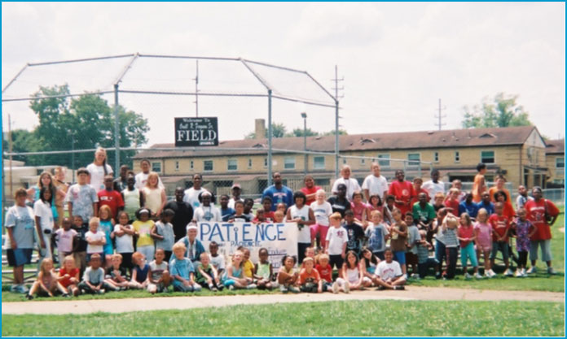
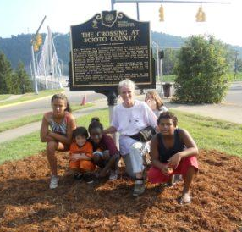
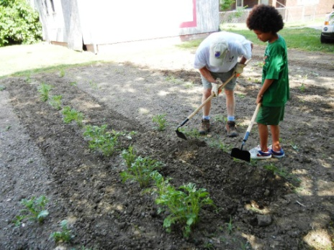

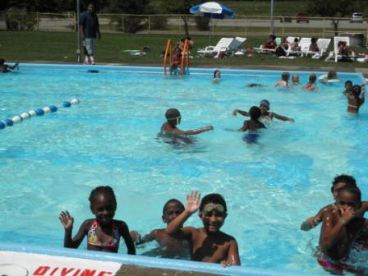
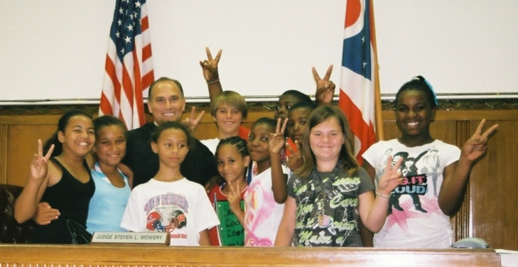
Prevention Services Summer Outreach Day Camp
Learning
Growing
Playing

Slide 6
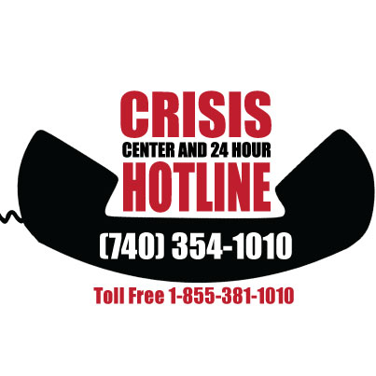
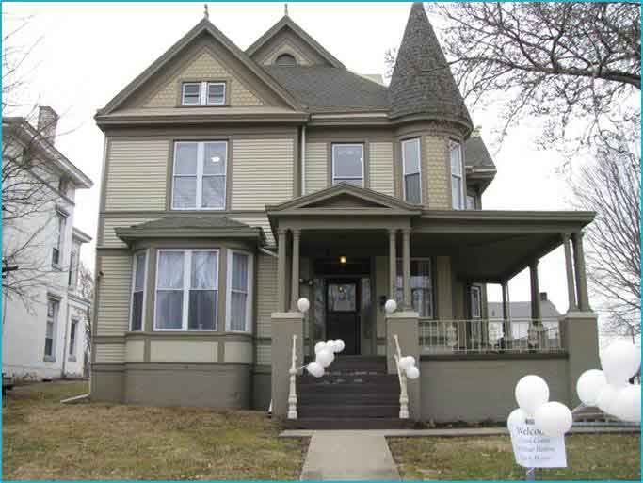
Crisis Center & 24 Hour Hotline
Crisis Center & 24 Hour Hotline
Second Street, Portsmouth
A service partnership between ADAMHS Board, OhioMAS, and The Counseling Center Inc.

Slide 7
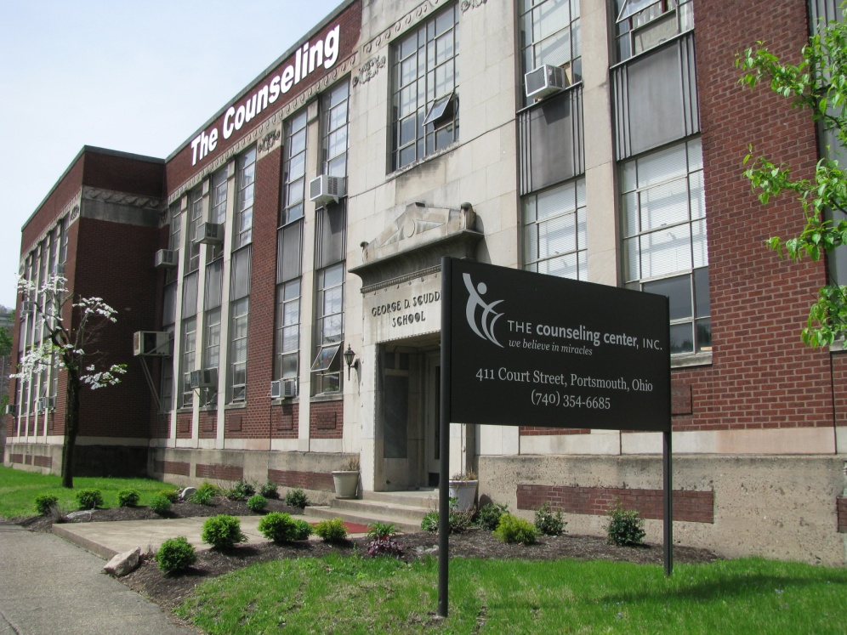
Outpatient Treatment Locations
Outpatient Treatment – Scioto County TCC on Court
411 Court Street, Portsmouth

Slide 8
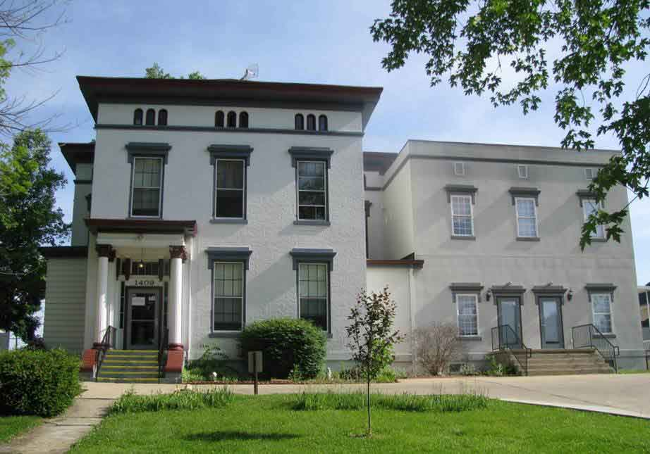
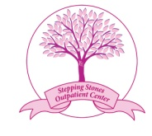

Stepping Stone House 1409 Second Street, Portsmouth
Stepping Stone House for Women with Children and Expectant Moms
Over 200 drug-free babies born since 2008

Slide 9

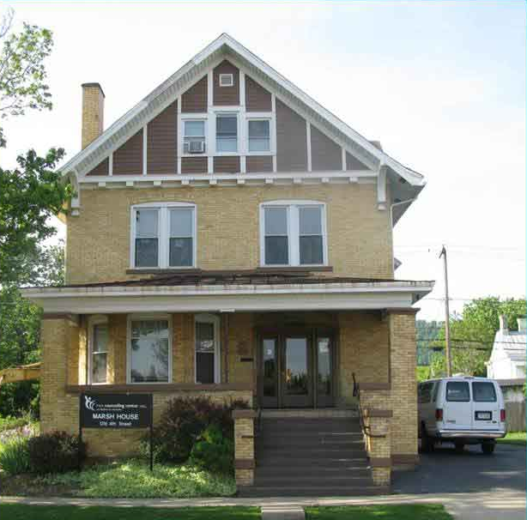
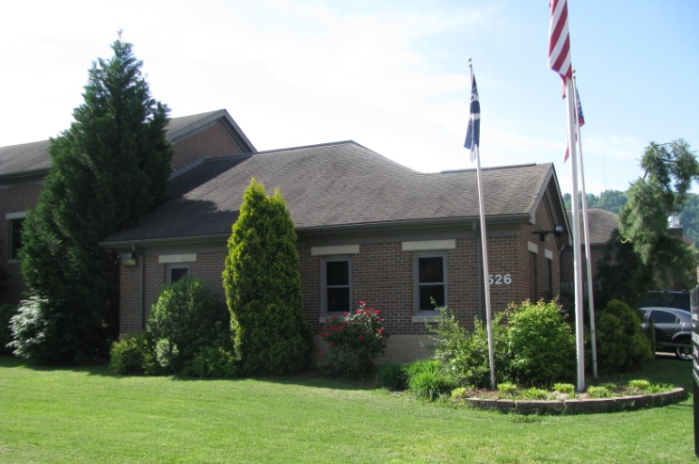
The James K. Marsh House for Men
1216 Fourth Street, Portsmouth
2nd Chance Center for Men
526 Fifth Street, Portsmouth

Slide 10
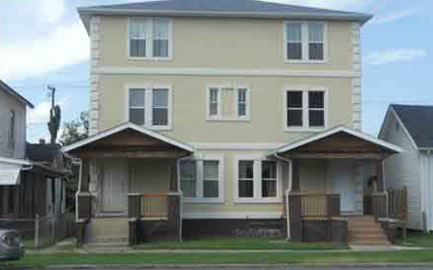
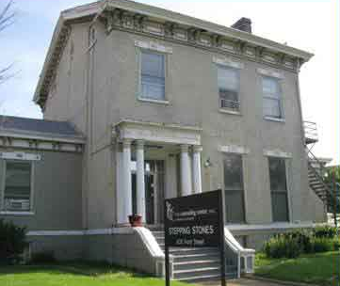
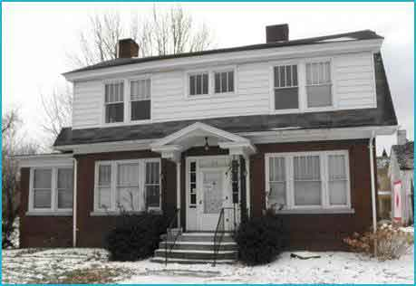
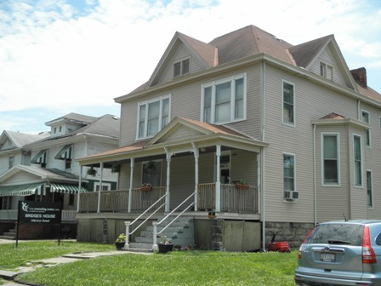
St. Lucy’s for Women
Scioto County
Women’s Transitional Living

Slide 11


Slide 12

Directions & Measures
Motivation
Goals &Time Management
Career Planning
The Resume
Networking & Tracking
Applications
Interviewing
Resources (Local & State)
Money Management
Email Operation
Google Drive and Microsoft Office
Typing Skills
Cash Register Operation
Customer Service
Local partnerships to provide employer specific education and financial literacy

Slide 13
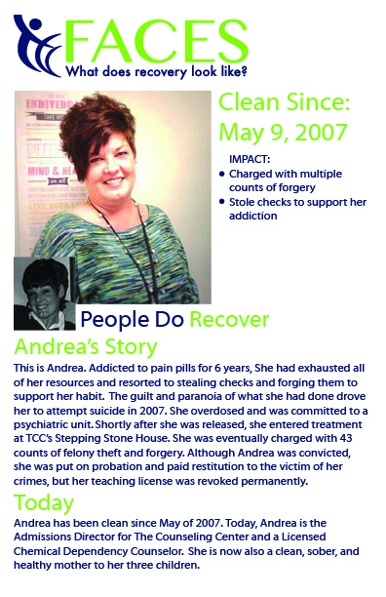
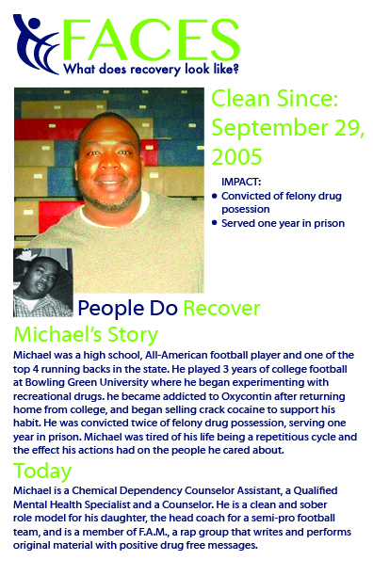

Slide 14

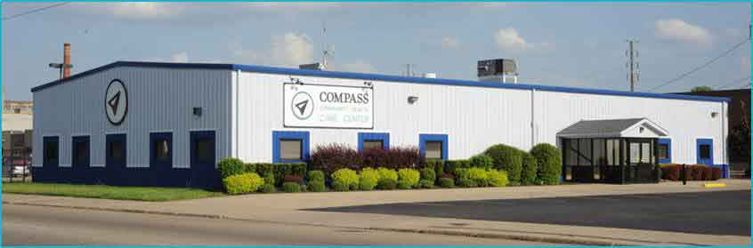
Compass Community Health Care Center
1634 Eleventh Street, Portsmouth
We believe everyone should have access to quality, affordable, integrated and coordinated
  Primary health care
  Behavioral health care services
  FQHC-LA designation

Slide 15
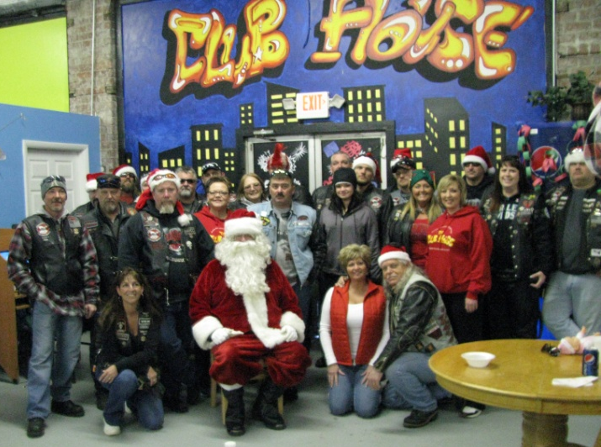
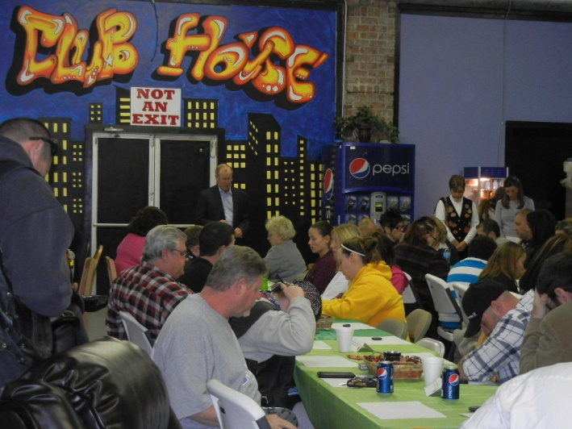

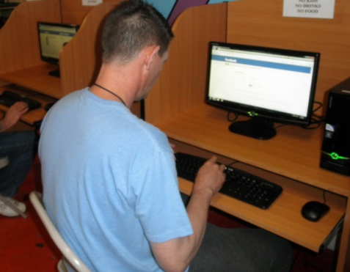
The Clubhouse
A clean and sober, safe, social space.
The Club House
2102 Eleventh Street, Portsmouth

Slide 16

Now in its 13th year, The Loved Ones Group offers free, confidential, education-based information for families or friends, who are concerned about a loved one’s alcohol or drug use. The cities listed here offer Loved Ones Group meetings:
Portsmouth, Ohio
West Union, Ohio
South Webster, Ohio
Wurtland, Kentucky
Huntington, West Virginia
Point Pleasant, West Virginia
South Charleston, West Virginia
Logan, West Virginia

Slide 17
We Believe
In
Miracles

